Slide 1
Community IPM National State Based Change Agent Report 2014-2015
Major investments and activities in school, housing and childcare programs.
Some efforts in other environments.
Schools Childcare Higher Ed Residential Migrant worker housing
Public/low housing Tribal housing Medical
Municipal Hospitality Industry Entertainment
Shelters Retail

Slide 2
Community IPM?
Low-income housing bed bug crisis.
Critically important bed bug working group established in the west (Andrew Sutherland et al.).
Tribes and Territories report lack of pesticide safety training for applicators.
Variety of new resources in the way of books, video, outreach materials.

Slide 3
Who is involved, and what are the top priorities?
Lack of on-site training, rodents, bed bugs, head lice
Schools: SLA, U/E, EPA Regions
Childcare: U/E
Higher Ed: U/E
Residential: U/E
Public/low housing: U/E
Tribal housing: SLA, U/E
Medical: SLA
Municipal: U/E
Hospitality Industry: SLA, Dept. Health, U/E
Migrant worker housing: SLA, U/E
Shelters:
Retail: SLA
Entertainment: U/E
Lack of staff education, head lice, bed bugs
Poor practices, poor policy, poor understanding, bed bugs
Unnecessary pesticide treatments, bed bugs, rodents
Bed bugs, lack of staff training, poor policy
Poor pest management practices, poor awareness, poor policy, bed bugs
Bed bugs, pesticide abuse, German cockroaches
Bed bugs, poor pest management practices
Poor pest management practices, lack of training, bed bugs
Lack of training, pharaoh ants, bed bugs
Bed bugs, rodents, lack of training and policy
Lack of training
Poor pest management practices, bed bugs

Slide 4
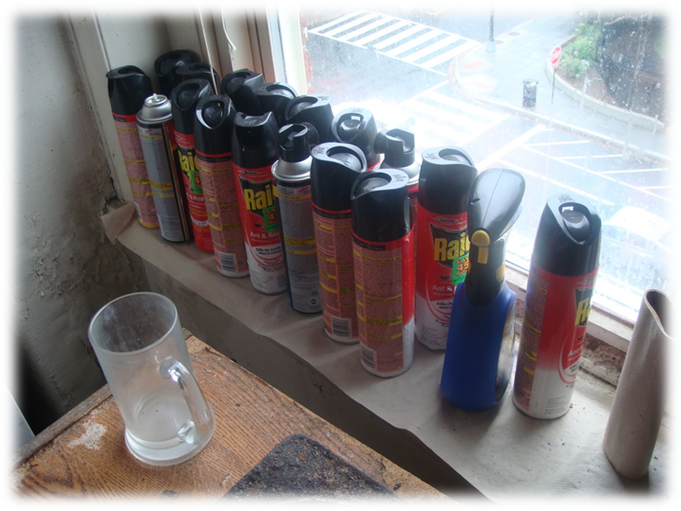
Who is involved, and what are the top priorities?
Bed bugs are a top priority problem in 12 / 13 environments (+ transportation, eldercare facilities).
Pesticide abuse referenced in low income housing specifically.
16.7% people bitten by bed bugs required medical treatment (Gouge et al. 2015)

Slide 5
What are people doing?
Schools
get the
most
General public outreach
Technical support upon request
Structured and targeted education – classroom style
Structured and targeted training – experiential learning practicum style
Site auditing and IPM improvement recommendation guidance
Comprehensive implementation facilitation
Facilitation of peer mentoring
Compliance assistance/enforcement
Training for certification and continual education

Slide 6
National School IPM 2020 Network
NIFA IPM Centers
Western Region School IPM Working Group
Dawn H. Gouge
Tim Stock
Southern Region School IPM Working Group
Janet Hurley
Fudd Graham
North East Regional School IPM Working Group
Lynn Braband
Kathy Murray
Carrie R. Foss
Deb Young
North Central Regional School IPM Working Group
Tom Green
School IPM Center of Expertise
+
Regions

Slide 7
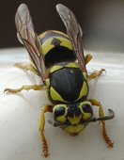
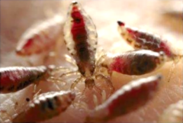
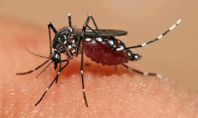
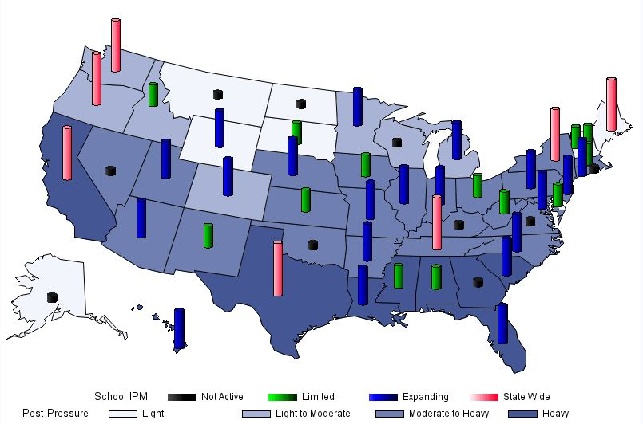
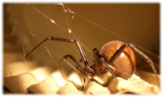
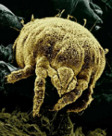
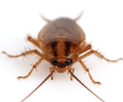
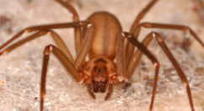
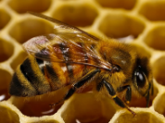
School IPM activity and pest pressure – state-based change agents
Notes:
40 out of 50 state contacts have responded based on activity statewide, not law, or compliance.

Slide 8
Are we empowered to implement IPM in our schools?
Competent change agents + rock solid leadership
Education & Training & Coordination
Accept feedback from stakeholders
Allow programmatic evolution (translational research will advance)
Education
Training
Coordination

Slide 9
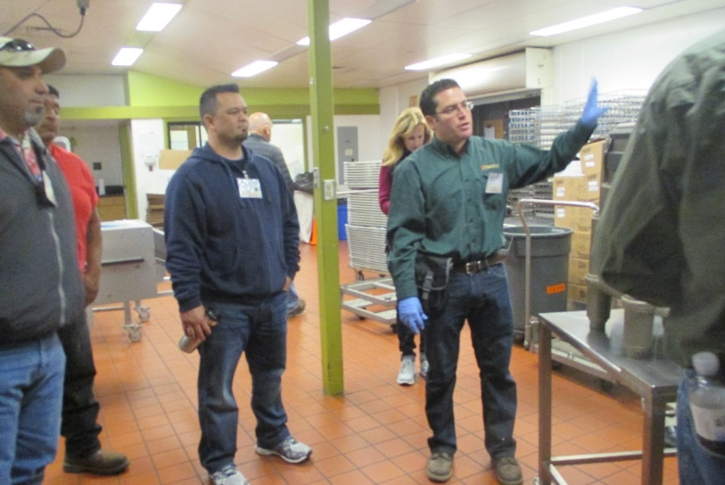
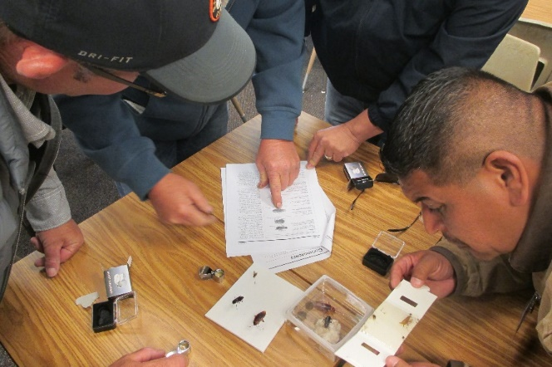
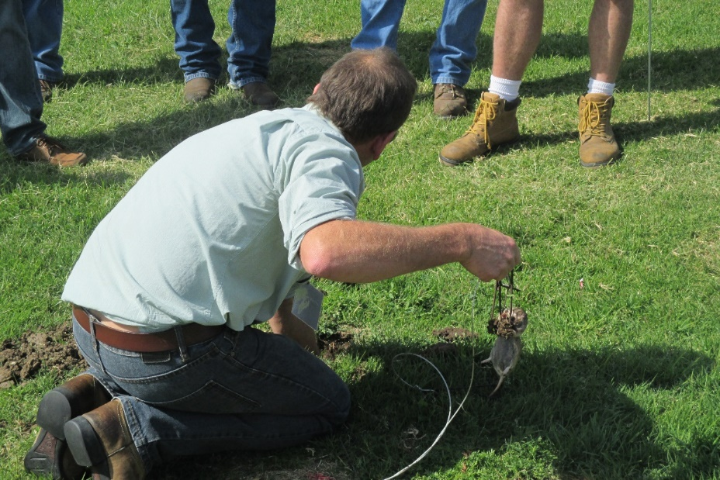
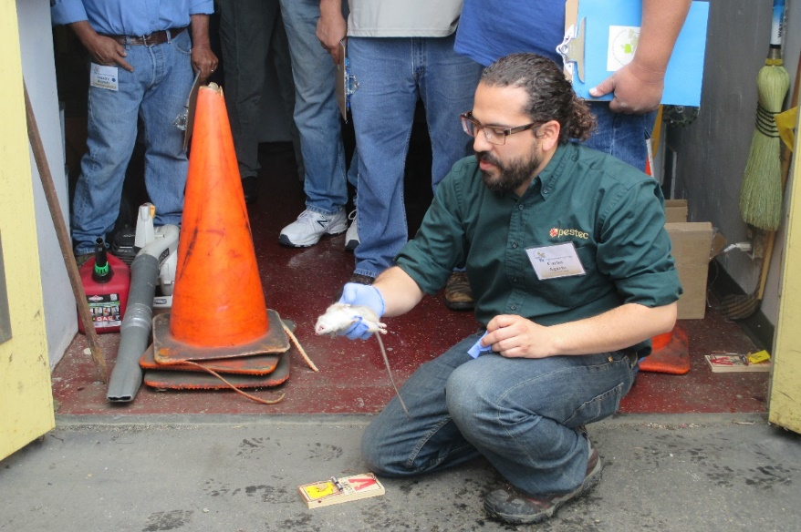
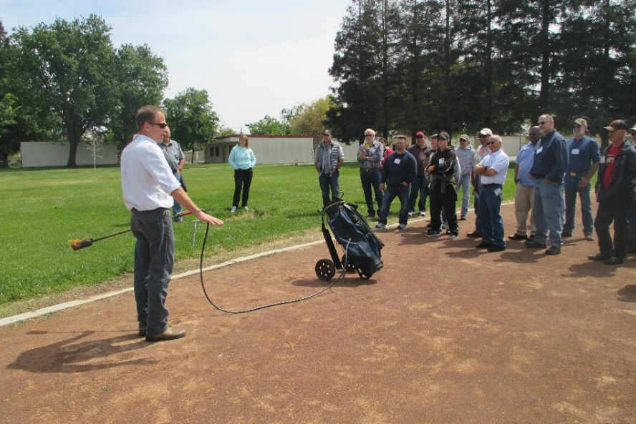
California DPR

Slide 10
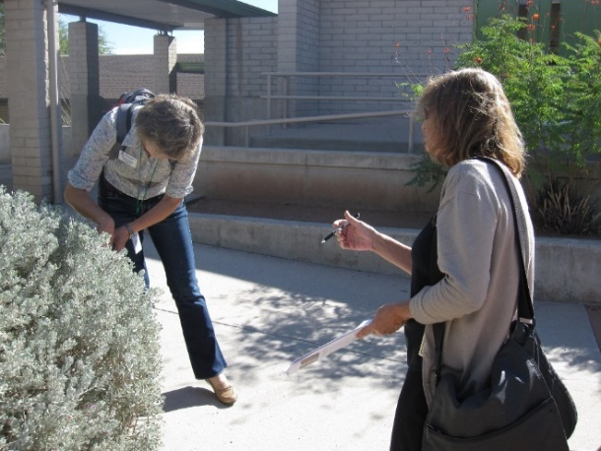
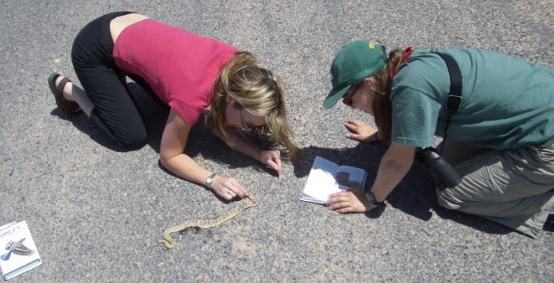
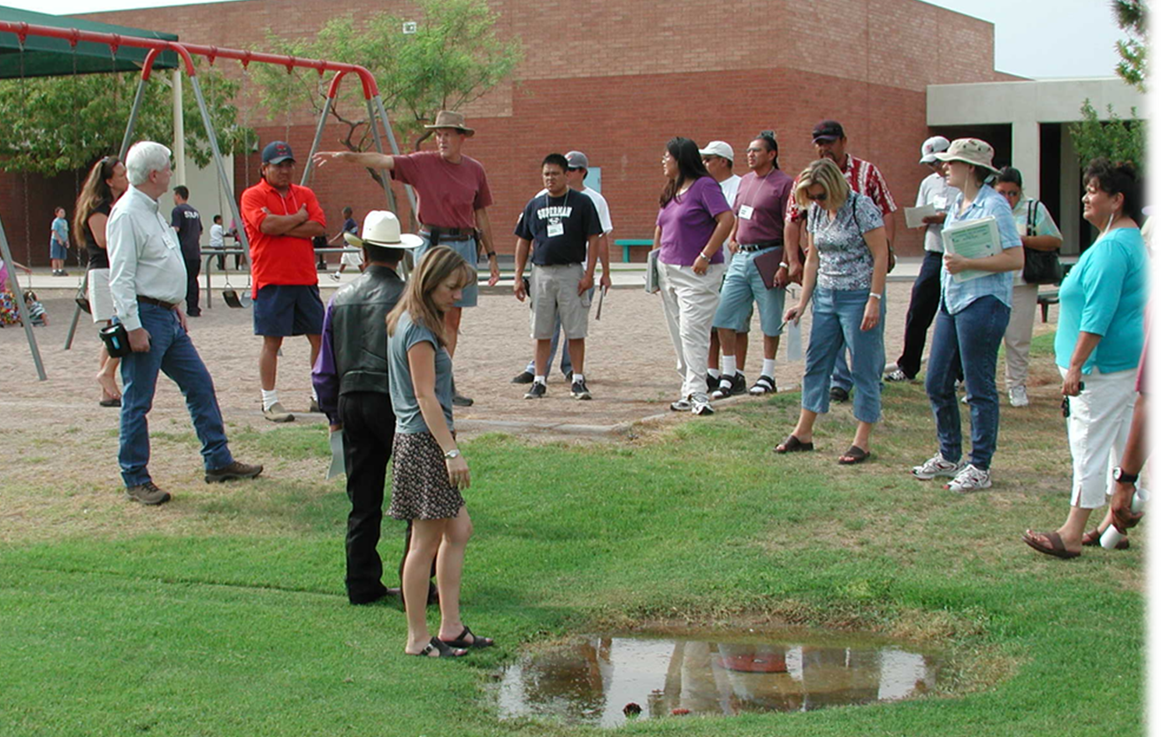
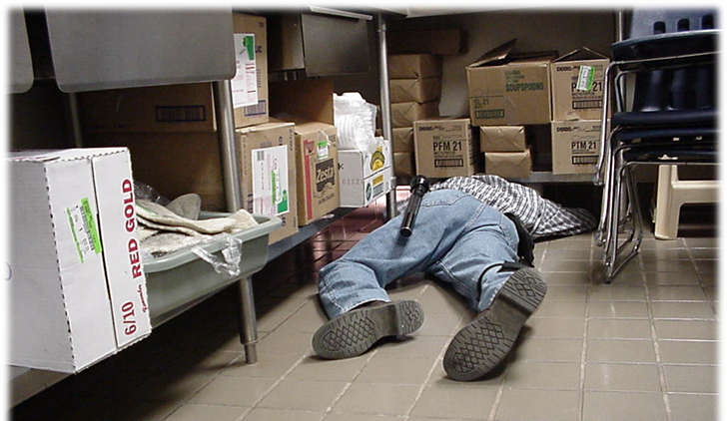
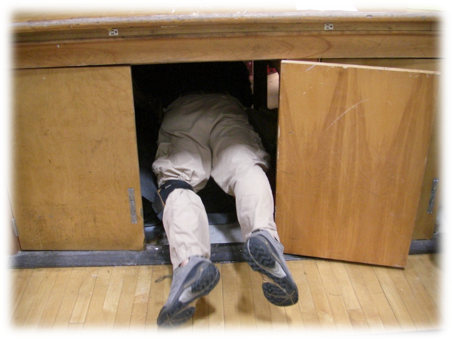
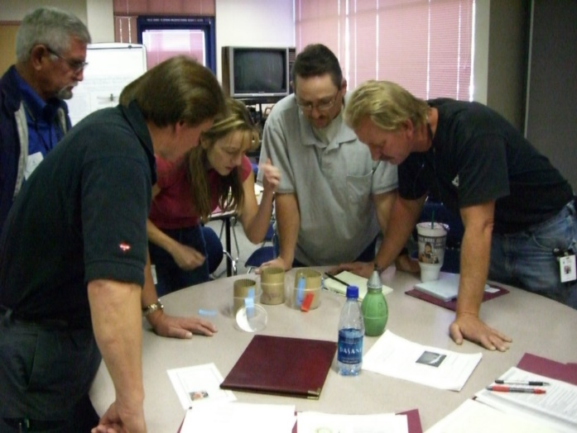
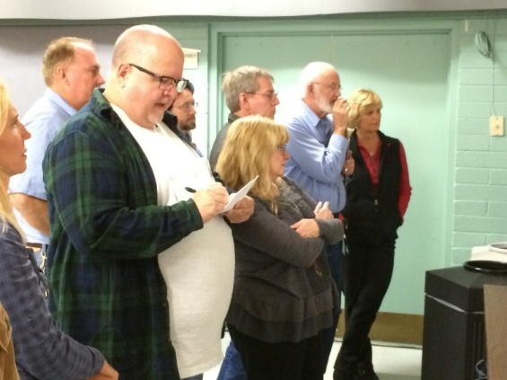
Arizona UA
This kind of learning occurs on the feet, knees, back, or stomach

Slide 11
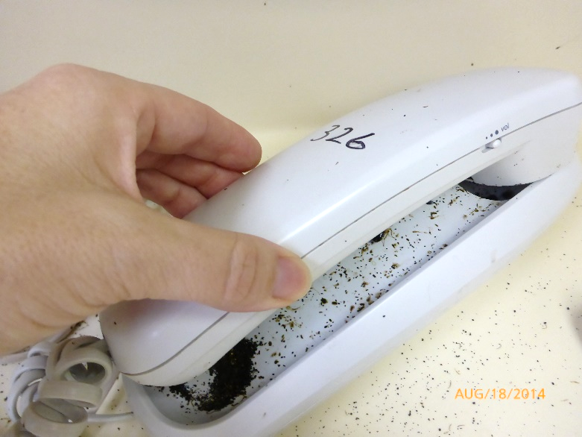
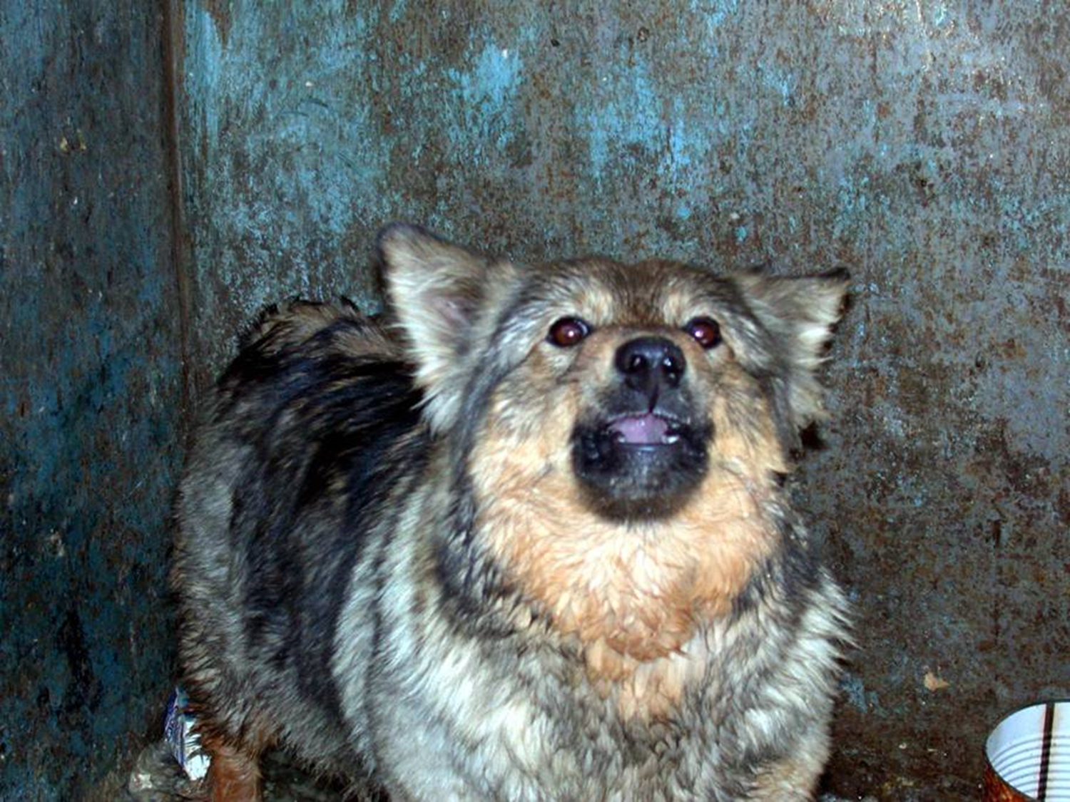
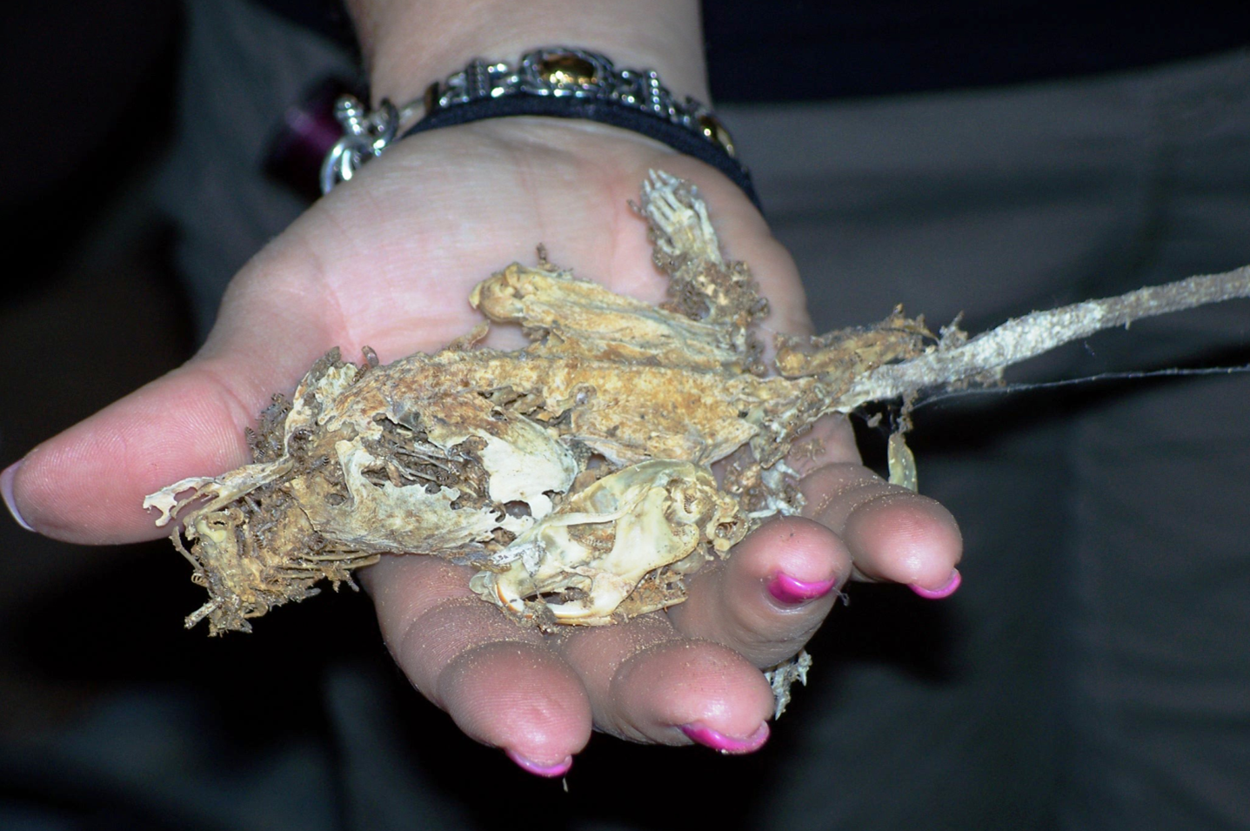
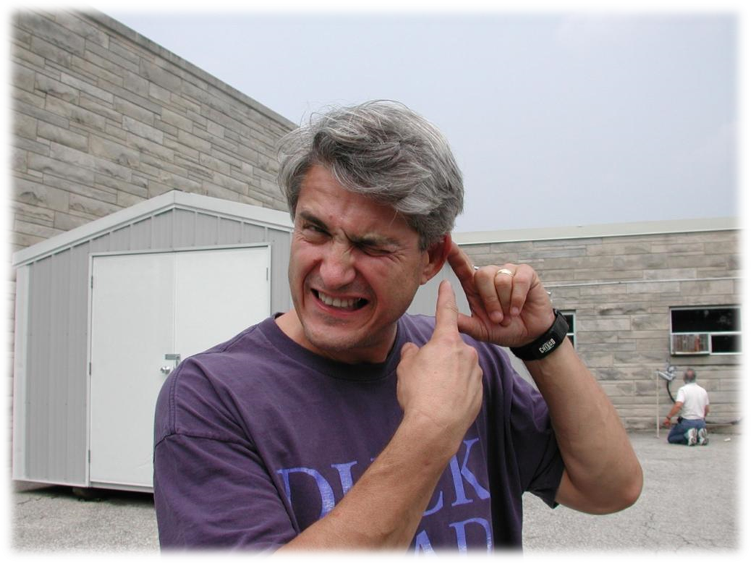
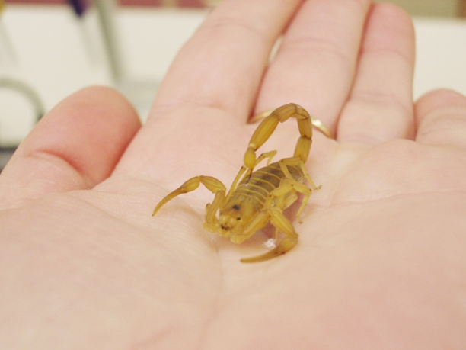
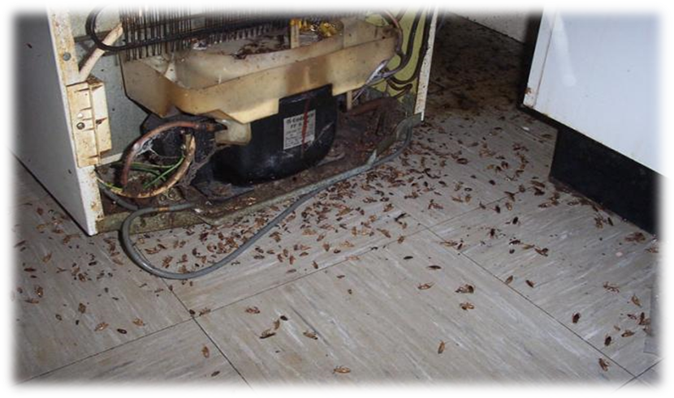
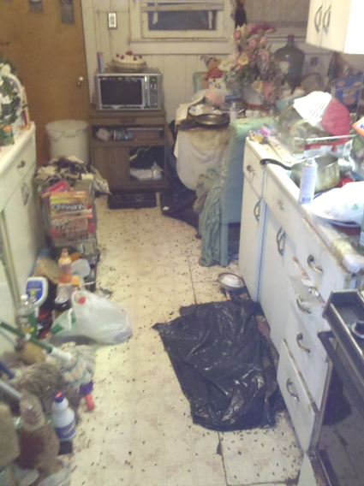
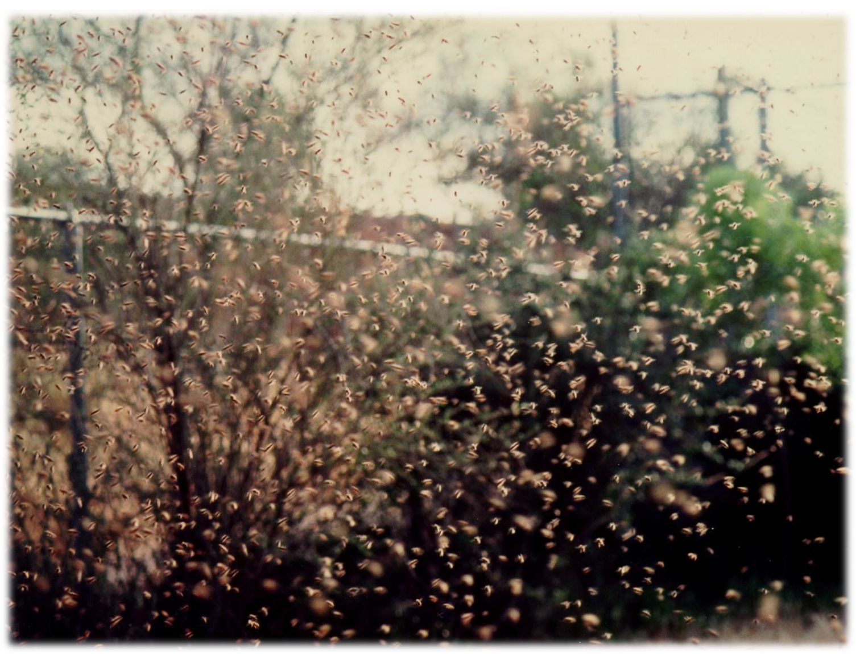
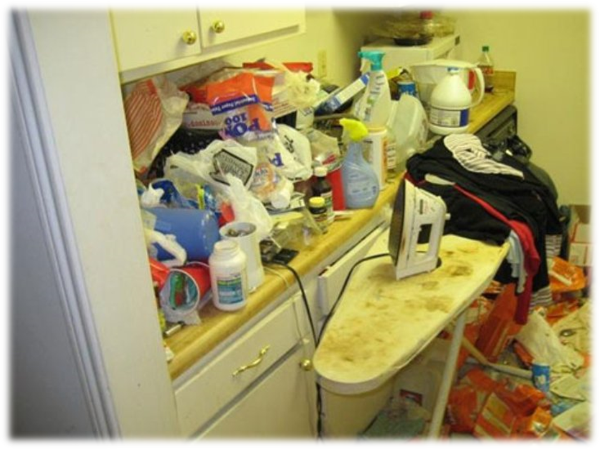
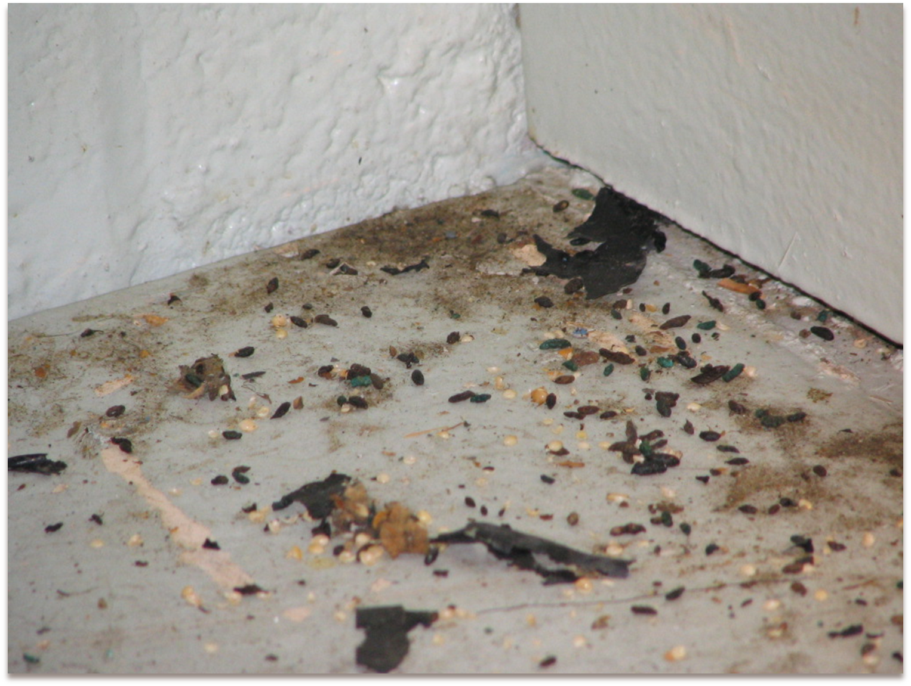
It’s a dirty job, and can hurt

Slide 12
School IPM 2014-2015?
Washington State School Expansion Pilot
School IPM Pest Management Strategic Plan 2020
NPMA partnership on school IPM standards
School related pesticide application legislation increasing nationally
But - reduction in change agent workforce

Slide 13
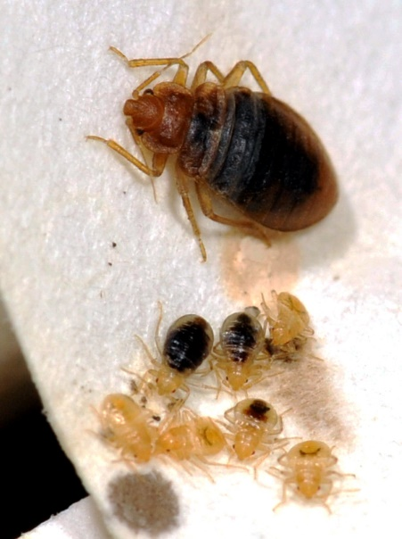
Other IPM Issues?
Tribes and Territories report desperate need for pesticide safety training for applicators
Pesticide abuse evident, particularly in low income housing specifically
Bed bugs

Slide 14
Other IPM Issues?
CA ag. pesticide use data indicates:
Reduction in reproductive toxicants, cholinesterase inhibitors, and ground water contaminants
No change in carcinogens
Possible increase in fumigant use
Western Region IPM Center Report

Slide 15
Dude where’s the bug spray?
Emerged issue

