Slide 1
Isabella A. Abbott, PhD
Brunno Cerozi

Slide 2
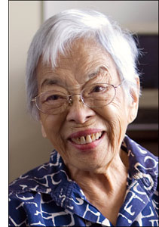
Education
BA in Botany, 1941, University of Hawaii
MS in Botany, 1942, University of Michigan
PhD in algal taxonomy, 1950, University of California

Slide 3
Achievements
First person of Hawaiian ancestry to earn a PhD in science
First woman on the biological sciences faculty at Stanford University
Considered the foremost expert on central-Pacific algae

Slide 4
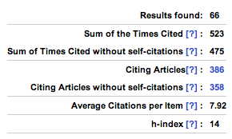
Publications

Slide 5
Publications
Authored eight books and over 150 publications
More than 200 algae “owe” their discovery and scientific names to “Izzy”
Including the Rhodomelaceae family (red algae) genus of Abbottella
This has earned her the nickname "first lady of limu”

Slide 6
Most relevant publication

Slide 7
Curiosities
Was the only girl and second youngest of eight siblings
Her mother was fascinated by plants and had a great knowledge about the local seaweeds
Dr. Abbott and her siblings were always collecting seaweeds with their mother

Slide 8
Dr. Abbott: an example of dedication to science

