Slide 1
ChengKui Tseng
- ENVS 575 Phycologist report

Slide 2
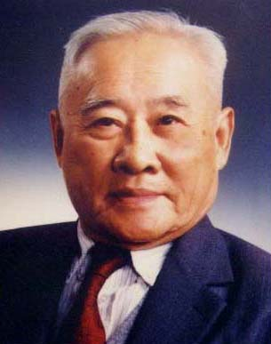
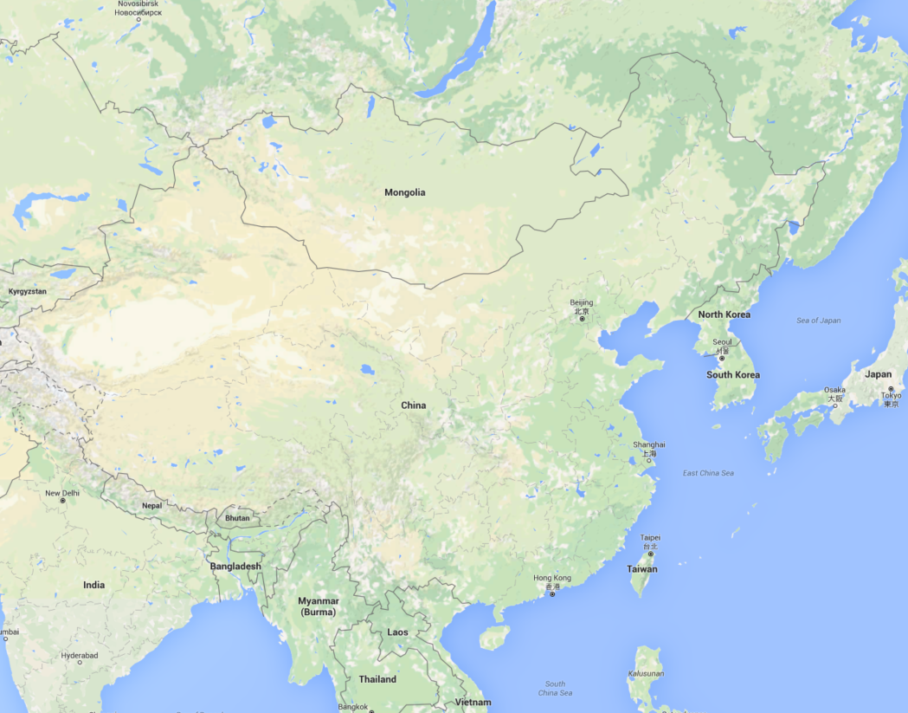
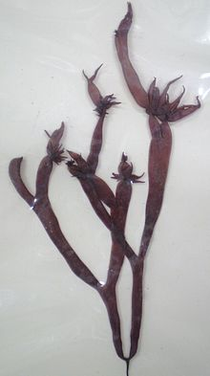
The road he took
1909 Xiamen, Fujian
1931 B.S. Xiamen Univ.
Gloiopeltis (赤菜 chicai)
Qingdao
M.S. Lingnan Univ.
His first paper
-1940 Shandong National Univ.
Lingnan herbarium
International communication
Xiamen
Guangzhou
1942 Ph.D. Unvi. of Michigan

Slide 3
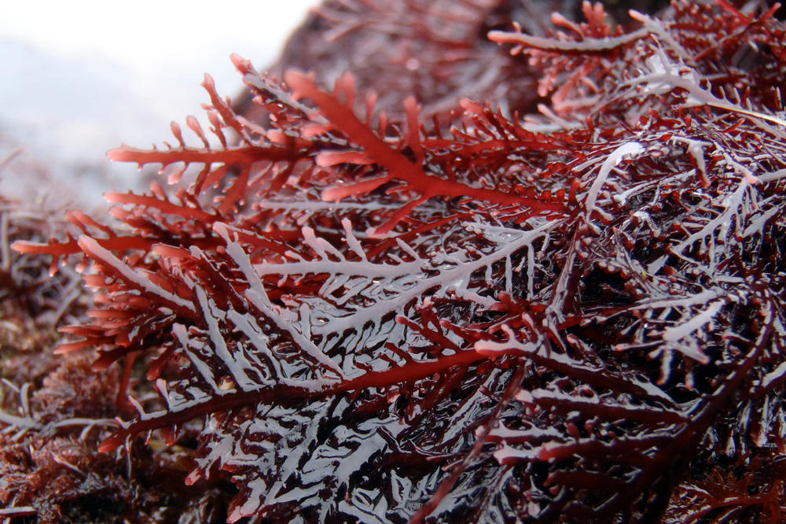
At Scripps Research Institute
Basic science or applied science
Agar weeds survey
Marine algae processing
Made in U.S.
Gelidium

Slide 4
The start of marine algae research in China
1947 Rebuilding of department of Botany, Shandong Univ.
1947 The Institute of Oceanography and Limnology
1949 Marine Biological Laboratory of the Chinese Academy of Sciences
1959 Institute of Oceanology

Slide 5
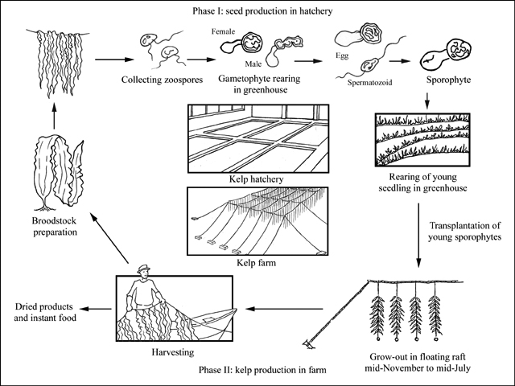
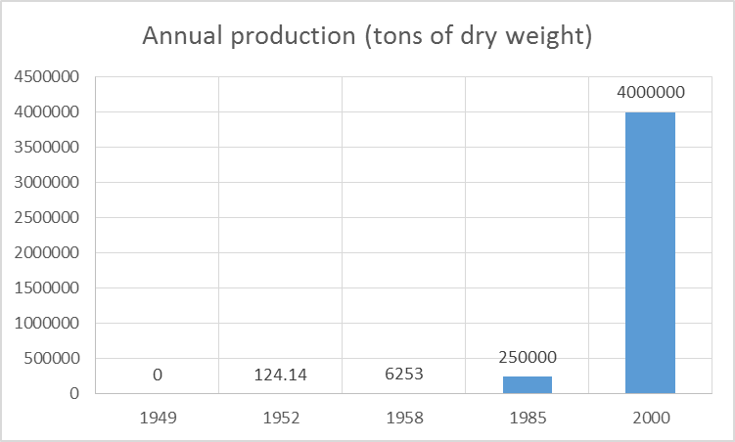
Laminaria farming in China
Algin: Medicine and food industry
Iodine: Goiter

Slide 6
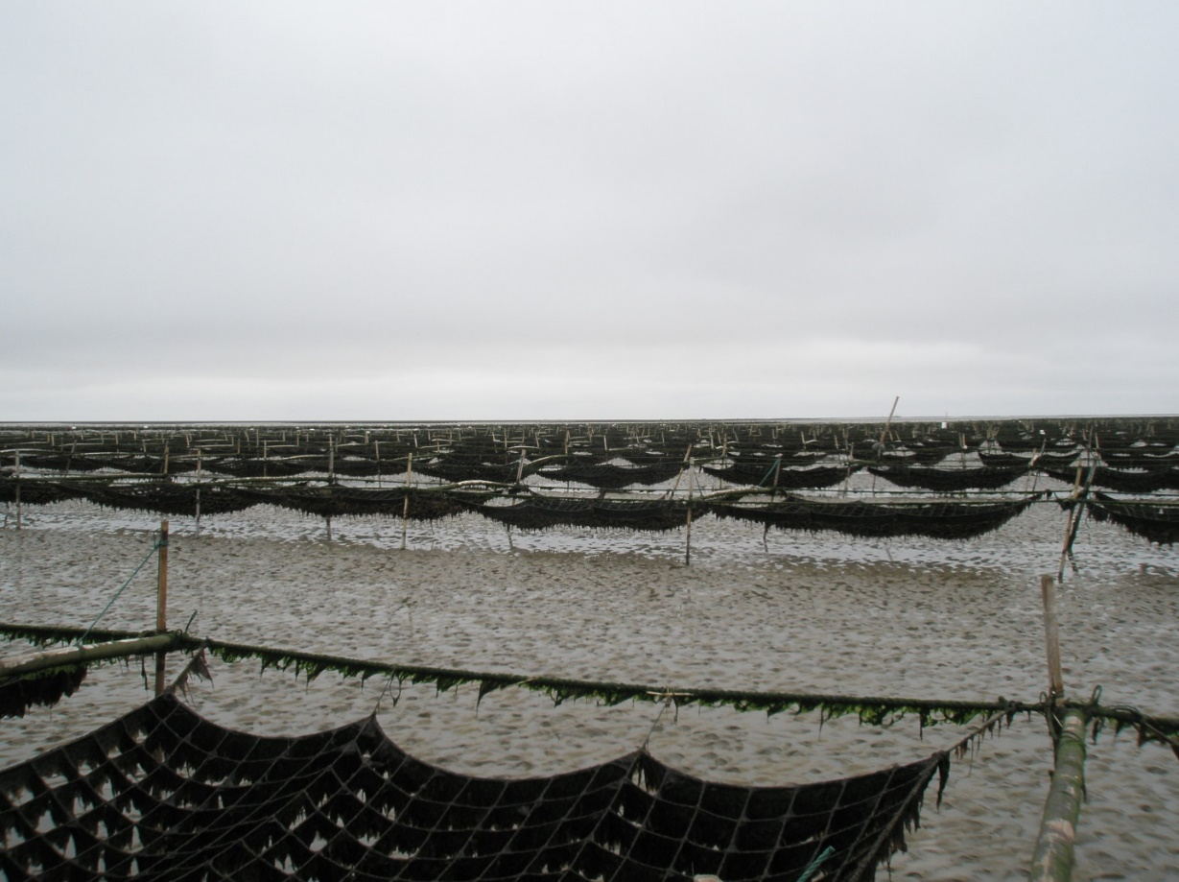
Laminaria farming in China
(These are Porphyra farming rafts)

Slide 7
Major Achievements
Survey of seaweed resource
Laminaria farming
Porphyra life cycle study and breeding (Conchospore)
Seaweed chemical industry
Evolution study of photosynthesis of seaweed
The first seaweed genetic engineering laboratory in China

Slide 8
Reference
P. Neushul & Z. Wang, (2000). Between the Devil and the Deep Sea: C.K. Tseng. Mariculture, 91(1), 59-88. http://www.jstor.org/stable.237558
FAO Fisheries and Aquaculture Department (2004). Cultured Aquatic Species Information Programme. Retrieved from: http://www.fao.org/fishery/culturedspecies/Laminaria_japonica/en
曾呈奎 .Retrieved from http://baike.baidu.com/link?url=RjDrHTGrbMdZDfS35bzBVv2wQaFt64l8has3KDjE5w1spsPpkAJwwfIh-IEbfVlx7zm-K-p0M4NHejzwuNMw5_

Slide 9
Thank you!

