Slide 1
Environment of the San Francisco Bay
Amber Dalke
Carrie Joseph
Logan Schiller
Dayna Tang
Jessica Thompson
Tyler Tomplkins
Julie Tran

Slide 2
Objectives
Environment
Wetland loss
Freshwater Flow
Native and Introduced Species
Song Sparrows
Asian Clam
Spartina Hybridization
Contamination in the Bay
Fish Toxicity
Selenium in the North Bay

Slide 3
Meet San Francisco!
Human settlements found from early as 3000BC
City of San Francisco founded 1776 by the Spanish
2010 City of SF
Population: 805,235 people
Area: 46.9 sq. miles
Pop. Density: 17,179 people/sq. mile (2nd highest in US)
2010 Bay Area
Population: 7.15 million people
Area: 8,818 sq. miles
Pop Density: 846 people/sq. mile

Slide 4
SF and the Bay
wikipedia.com
Notes:
The Bay Area is made up of three bays and their associated rivers, riparian flats and deltas, coastal areas, and other wetlands. The small, northeasternmost bay is Suisun Bay (“suh-soon”, named after Native American tribe who lived in the area, Suisin marsh is largest marsh in CA), which receives the waters from the San Joaquin and Sacramento Rivers. It flows through the Carquinez Strait and meets with the waters of the Napa River in San Pablo Bay. San Pablo Bay is the round pool-like area west of the Carquinez Strait. It connects with SF Bay, which is considered to end at the Golden Gate Bridge where it officially “meets” the Pacific.

Slide 5
Natural Wetland Habitat
SF Bay is point where San Joaquin and Sacramento Rivers meet the Pacific Ocean
Flows west from Sierra Nevada Mountains
Endpoint of watershed, drains ~40% of CA
Historic size of riparian and tidal areas (pre-1850)
145 sq. miles of freshwater wetlands
Moist grasslands, vernal pools, and riparian forest
200 sq. miles of tidal marsh
23 miles of sand beaches
Notes:
Supports other various wetland types, including tidal marshes, evaporating salt pools, freshwater ponds and rivers, willow groves, riparian grasslands
--200 square miles of tidal marsh reduced to 63 square miles, but only 25 square miles are remaining historical marshes. This means that though the total wetland area has been reduced to 31.5% of its former size, 87% of the original historic wetland areas have been lost. The other present tidal marshes have naturally evolved from tidal flats, been restored from diked baylands, or have been created as part of water treatment projects.

Slide 6
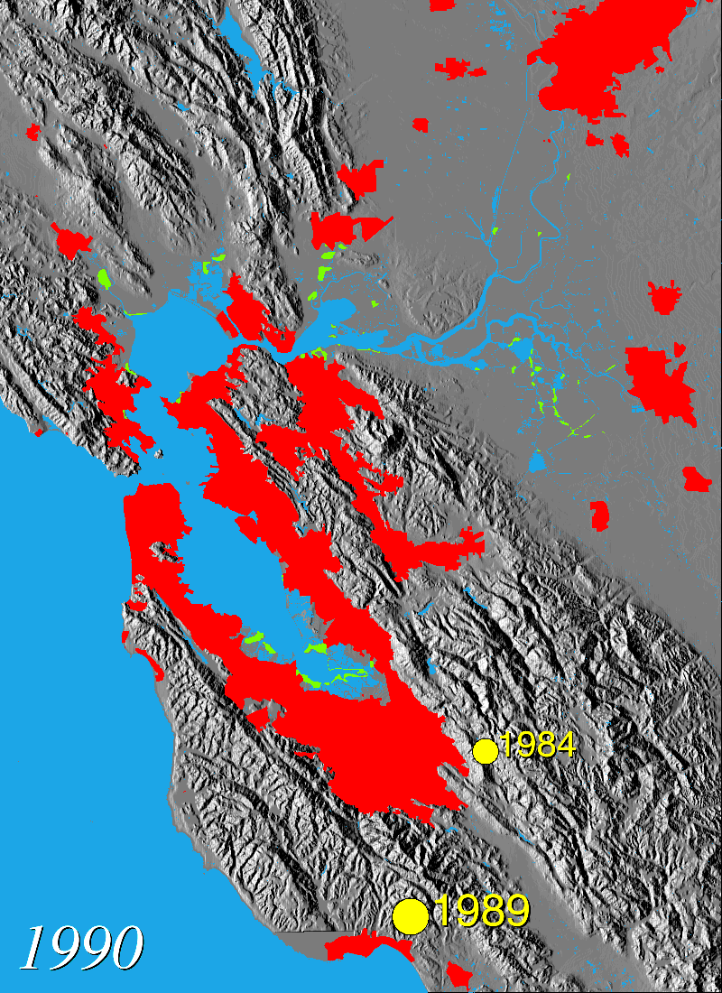
Wetlands and Urban Land
usgs.gov
usgs.gov
Notes:
Green = wetland
Red = urban land use

Slide 7
What’s Left?
Freshwater Wetlands
145 sq. miles reduced by up to 95%
Tidal Marsh
200 sq. miles reduced to 63 sq. miles
Only 25 sq. miles of remaining wetlands are historic
Notes:
Reduction in area: 68% loss
Percent of historic wetlands lost: 87%
Discrepancy in size of remaining historic wetlands and remaining overall wetland area caused by A) natural evolution of tidal marshes from tidal flats, B) restoration of diked bayland area, C) constructed wetlands for water treatment and other uses.

Slide 8
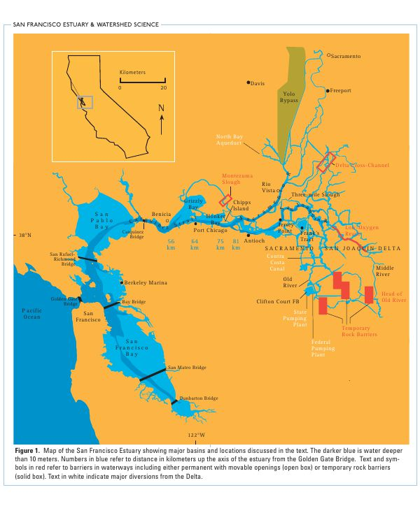
Freshwater Flow
Highly Variable
Altered by Dams and Diversions
Altered by Climate Change
wikipedia.com

Slide 9
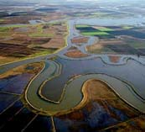
Diversions
Federal and State water export facilities
Moves water from north to south during the dry season
Most precipitation falls north of Delta
Most demand is south of Delta
usgs.gov

Slide 10
Problems
The Delta is home to many species of concern
Habitats being altered, un-natural patterns affecting species
Many conflicts over water use/rights
CALFED program
usgs.gov

Slide 11
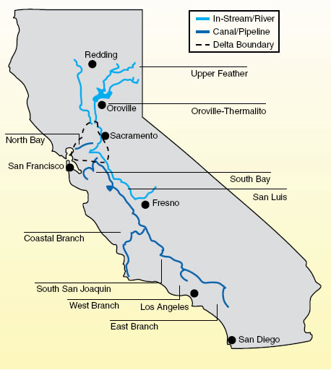
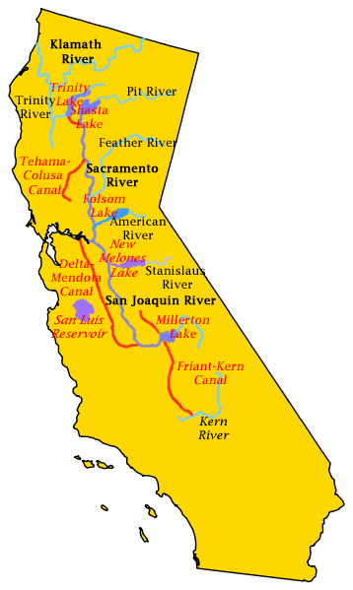
Why it Matters?
Influence the physical, chemical, and biological components of estuaries
The availability depends on the variable
Precipitation patterns
Water development projects
Central Valley Project (CVP)
State Water Project (SWP)
usgs.gov
usgs.gov

Slide 12
Reservoirs Effects on Flow
Purposes of Large Reservoirs
Flood control during winter
Release water throughout the year
Effects on Natural Seasonal Flows
Spring flow has decreased
Constant demand puts pressure on programs
Affecting the species dependent on flows

Slide 13
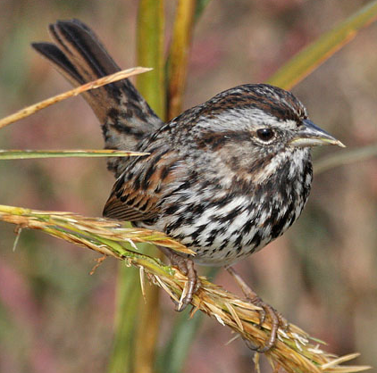
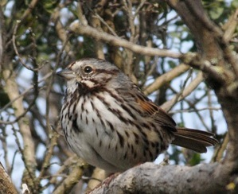
Salinity and Song Sparrows
Alameda Song Sparrow
Marin Song Sparrow
Is the Alameda Song Sparrow better adapted to live in salt-marsh habitats than Marin Song Sparrow?
pbase.com
colintacroft.com

Slide 14
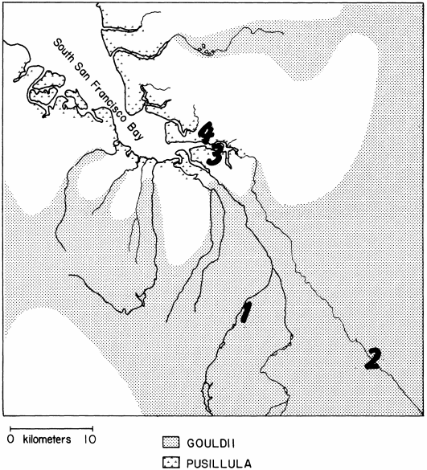
Method
Drinking solutions: tap water or seawater (25%, 50%, 60%)
NaCl was increased and maintained
0%, 20%, 30%, 40%, 50%, 60%, 70%, and 80%
Water consumption and weight loss and/or gain recorded
Basham 1987

Slide 15
Results
Tolerances of Seawater
50%: Both species
60%: Only 2 Alameda Song Sparrow
70%: Neither species
Conclusion:
Alameda Song Sparrow is more tolerant of seawater
Alameda Song Sparrow is better adapted to live in salt-water habitats

Slide 16
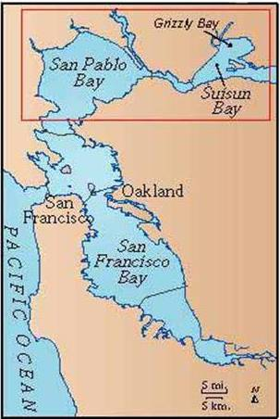
Invasion of the Asian Clam
Potamocorbula amurensis
Asian Clam
Spotted in 1986
Found in Grizzly and Suisun Bay areas
Increased in numbers between 1986 and 1988
geopubs.wr.usgs.gov

Slide 17
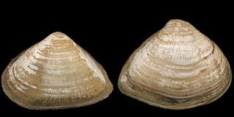
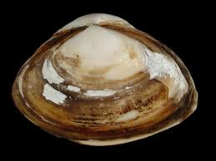
The Arrival of Asian Clams
Release of seawater ballast from cargo vessels
Ballast water contains large numbers of species
Found in mud, peat, hard clay, coarse sand, and mixed mud sand bottoms
Tolerate wide range of salinity and sediment types
Idscaro.net
Idscaro.net

Slide 18
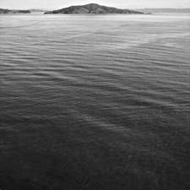
Impacts of Asian Clam
Elevated the level of salinity
Brackish Water in Winter
Competes with other species (mainly bivalves)
Behavior and movement disturbed surface sediment layers
Changes in benthic community energy flow
sanfrancisco.cbslocal.com

Slide 19
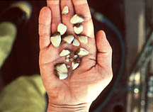
Studies of Asian Clams
Unclear why colonization was so successful
Long term consequences are unknown
Estuary vulnerable to exploitation
oar.noaa.gov

Slide 20
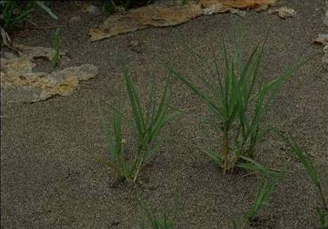
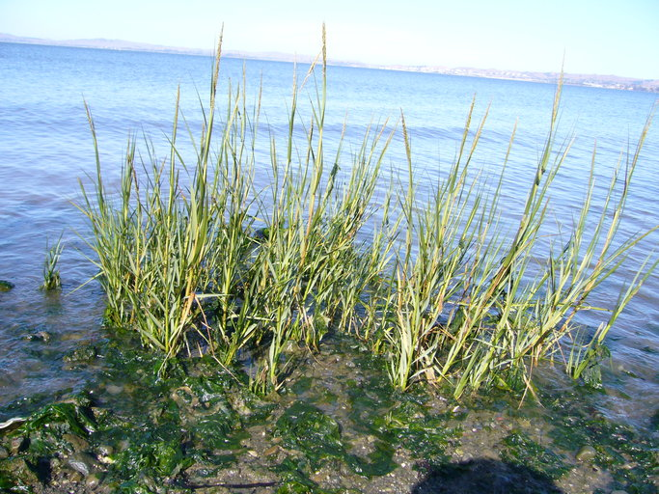
Spartina spp.
Native Spartina
Non-native Spartina
Hybridization
Spartina foliosa (California cordgrass)
Spartina alterniflora (smooth cordgrass)
Calphotos.berkeley.edu

Slide 21
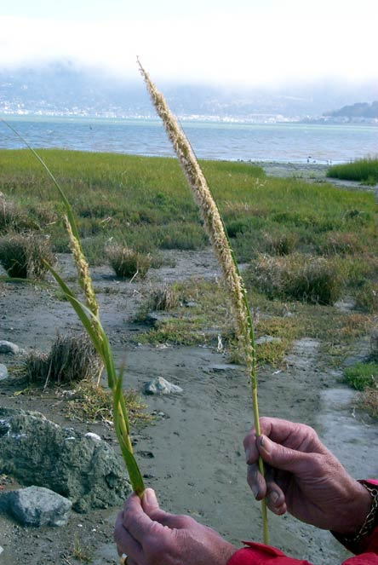
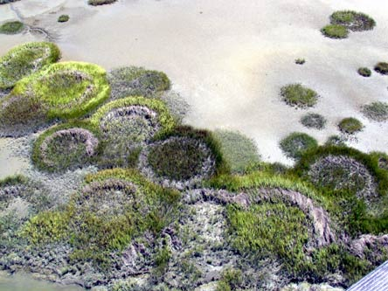
Hybrid Spartina Characteristics
Produce larger plants
Greater pollen count
Faster growth rates
Greater tidal ranges
Self-pollination
Spartina.org
Spartina.org

Slide 22
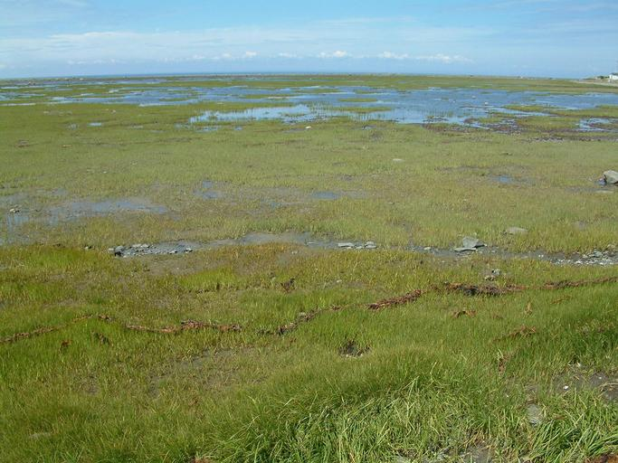
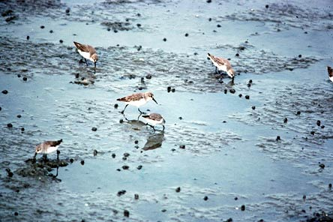
Non-Native and Hybrid Impacts
Conversion of Tidal Mudflats to Meadow
Loss of Critical Habitat
Loss of Shorebird Foraging Habitat
Local Extinction of Native Cordgrass
Endangered Species
Calphotos.berkeley.edu
Spartina.org

Slide 23
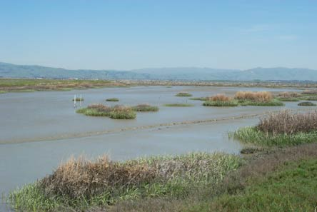
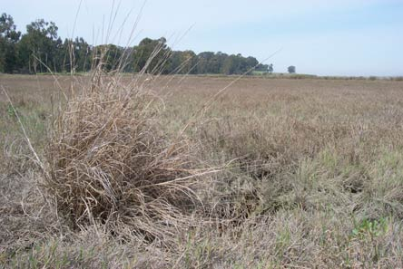
State of Invasion
At Risk Areas
Possible Controls
Spartina.org
Spartina.org

Slide 24
Fish Contamination
museumca.org

Slide 25
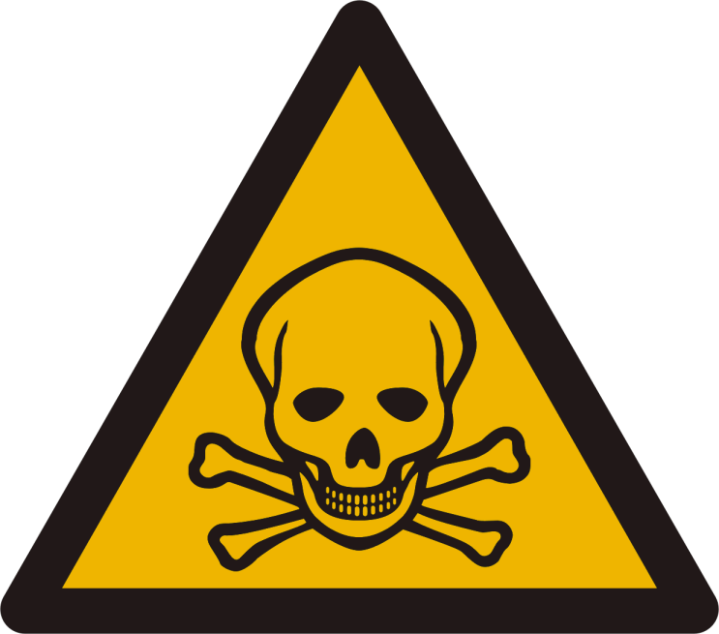
The Problem
Toxins:
PCBs, mercury, DDT, dieldrin, chlordane, and dioxins/furans.
Biomagnification makes fish unsafe for human consumption
Effects: cause cancer, birth defects, and damage to the immune, nervous, and reproductive systems.
fundraw.com
liveliketime.com
Notes:
Enter watershed via agricultural runoff

Slide 26
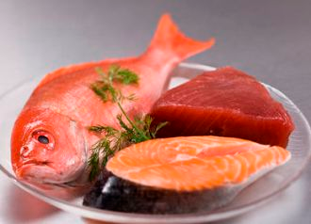
Consumption Safety
Two meals caught in the bay/month maximum
Most Unsafe
No striped bass over 27 inches
No large shark over 24 inches
Safe
Salmon
Anchovies
Herring
Smelt
onlinecancerguide.com

Slide 27
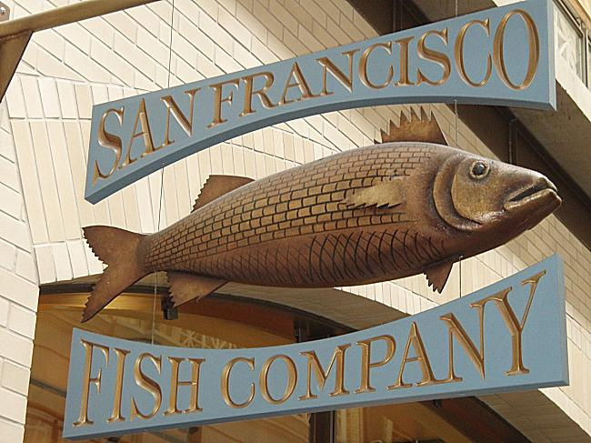
Extent of the Problem
Exceeding Maximum Allowed Levels
50% fish exceeded levels of PCBs & mercury
37% samples exceeded in levels of DDT & chlordane
SF Bay seafood no longer for sale on retail market
Aquatic organisms can bioconcentrate contaminants up to 100,000 times that detected in the water column
yellowbot.com

Slide 28
Fish Contamination 1997
Fairey et al. 1997

Slide 29
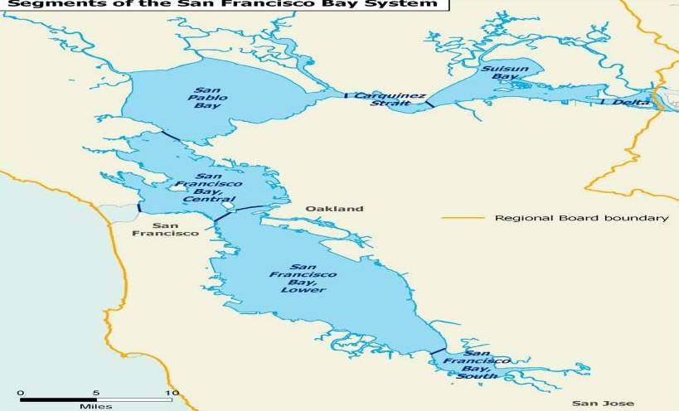
Selenium Contamination
1,600 sq. miles
Drinking Water: 70% of CA
Irrigation Water:
4.5 million acres
5 segments
swrcb.ca.gov

Slide 30
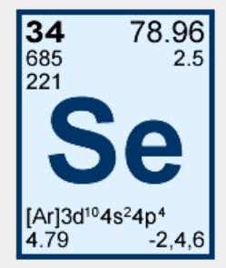
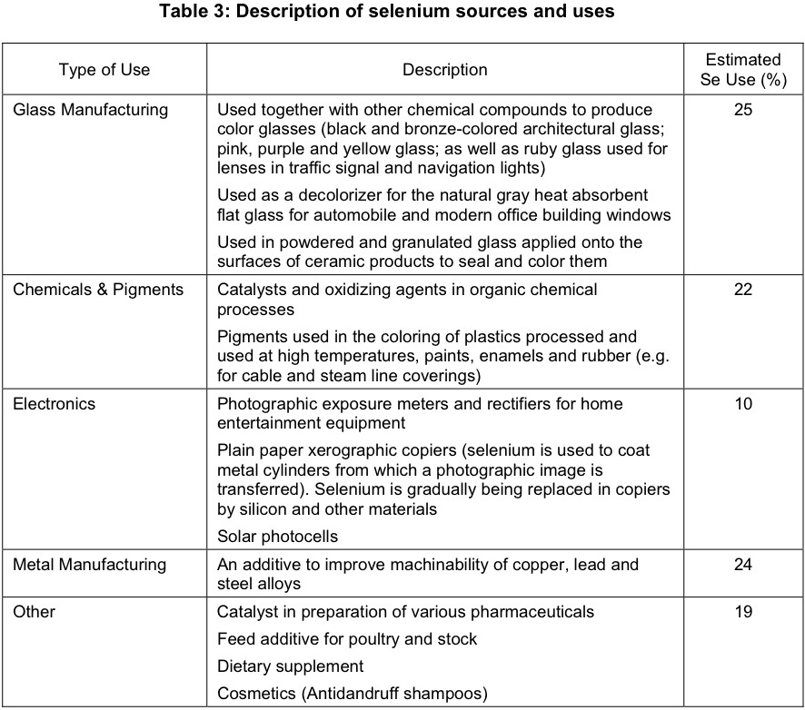
What is Selenium?
Naturally Occurring in Sediment
Anthropogenic Sources
USGS 2004

Slide 31
Internal and External Sources
USGS 2004

Slide 32
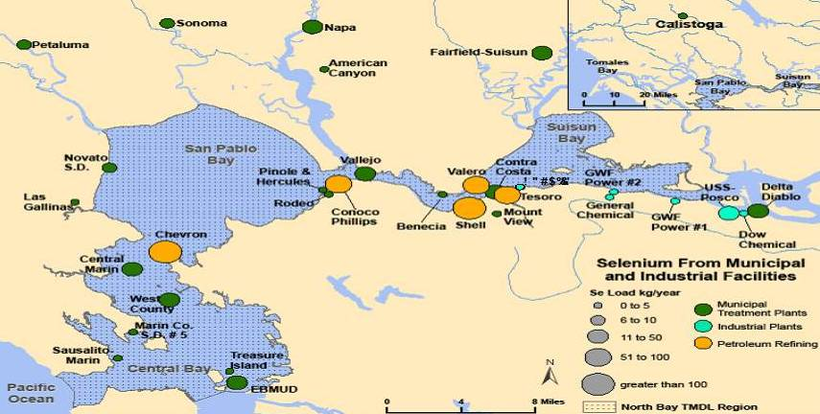
Point Source Discharges
Effluent discharge directly or indirectly by industrial & municipal facilities
22 POTW’s
6 minor industrial plants
5 refineries
swrcb.ca.gov

Slide 33
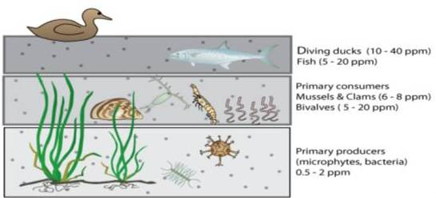
Next Steps
ECoS3 Estuary Model
Biological productivity, total suspended material, salinity, nutrients, and trace metal behavior
Forecasts small changes in particulate selenium
Se characterization study by petroleum refineries.
Wetland restoration – phyto studies
swrcb.ca.gov

Slide 34
Environment of the SF Bay
Environment
Wetland loss
Freshwater Flow
Native and Introduced Species
Song Sparrows
Asian Clam
Spartina Hybridization
Contamination in the Bay
Fish Toxicity
Selenium in the North Bay

