Slide 1
Effect of Pulsed Feeding on Growth, Gut Metagenome, and Intestinal Nutrient Transporters of Tilapia in Pond Culture
Russell J. Borski¹, Scott A. Salger¹, David A. Baltzegar¹, Jimi Reza², and Md. Abdul Wahab²
¹ Department of Biological Sciences
North Carolina State University
² Department of Fisheries Management
Bangladesh Agricultural University

Slide 2
Background
Tilapia production > 5 million metric tons
50-70% of production costs for tilapia is attributable to feeds. Reducing costs through improved feed management strategies or formulations is important.
Gut microbes are essential to efficient digestion of nutrients, energy homeostasis, innate immunity, maintenance and growth of epithelium
Role of gut microbes in tilapia nutrient utilization, growth, and health poorly understood – the metagenome has yet to be evaluated in growout of tilapia.
Notes:
Formulated feed (30% CP) initially at 10% of body weight/day were supplied. We began with 10% BW/day and titer down to 2%
Fertilized with urea and triple super phosphate (TSP) at the rates of 4:1 as N: P

Slide 3
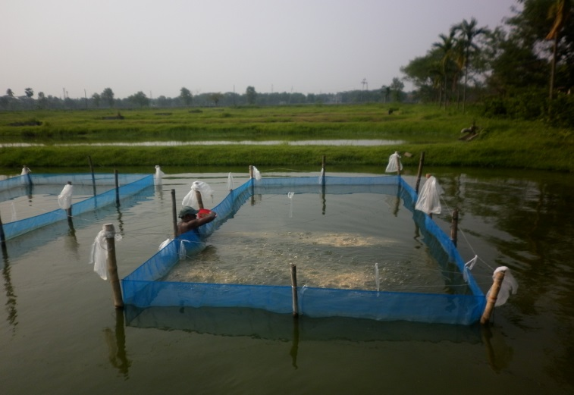
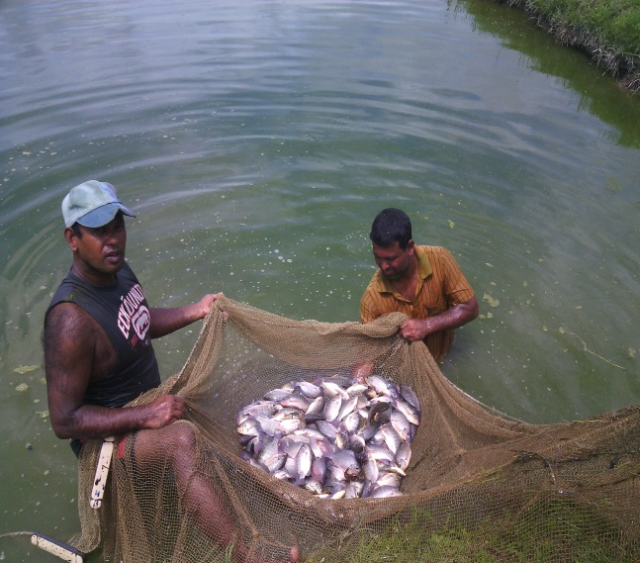
Objectives
Evaluate the effectiveness of pulsed feeding strategies (e.g. daily, alternate day, every 3rd day feeding) on Nile tilapia (Oreochromis niloticus) production
Identify key molecular factors associated with nutrient uptake efficiency (nutrient transporter gene expression)
Characterize changes in gut microbial communities in response to pulsed feeding strategies
Notes:
This study addressed these issues by demonstrating that equivalent production yields can be achieved with pulsed feeding strategies utilizing much less feed (50% reduction), thereby reducing feed and labor costs.
Additionally, this study examined how pulsed feeding strategies may enhance nutrient absorption by measuring nutrient transporter abundance and gut microbial diversity in response to different feeding regimes.
Decrease costs of feed input
Maintain quality of product
Determine mechanisms to these savings

Slide 4
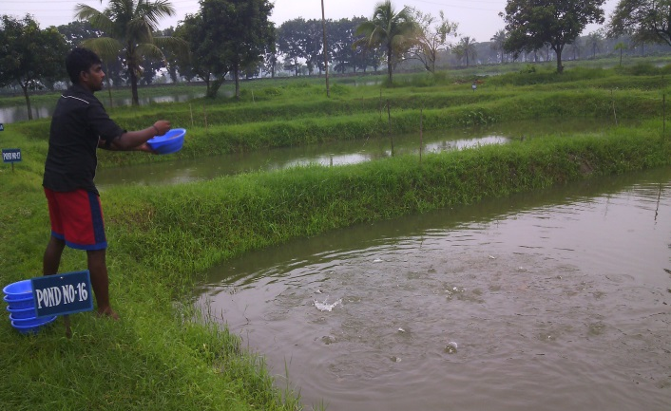
Study Design
12 Week Pond Study – Fisheries Field Laboratory, Bangladesh Agricultural University
Gene Expression and Metagenomics Studies – NC State University
Treatment/ Factors | Treatment 1 | Treatment 2 | Treatment 3 | Treatment 4 | Treatment 5
Stocking Density | 5 fish/m² | 5 fish/m² | 5 fish/m² | 5 fish/m² | 5 fish/m²
Feeding strategy | daily feeding | alternate day feeding | feeding every 3rd day | no feeding | daily feeding
Pond Fertilization | 4 : 1 (N:P), Weekly | 4 : 1 (N:P), weekly | 4 : 1 (N:P), Weekly | 4 : 1 (N:P), Weekly | no fertilization
Notes:
Formulated feed (30% CP) initially at 10% of body weight/day were supplied. We began with 10% BW/day and titer down to 2%
Fertilized with urea and triple super phosphate (TSP) at the rates of 4:1 as N: P

Slide 5
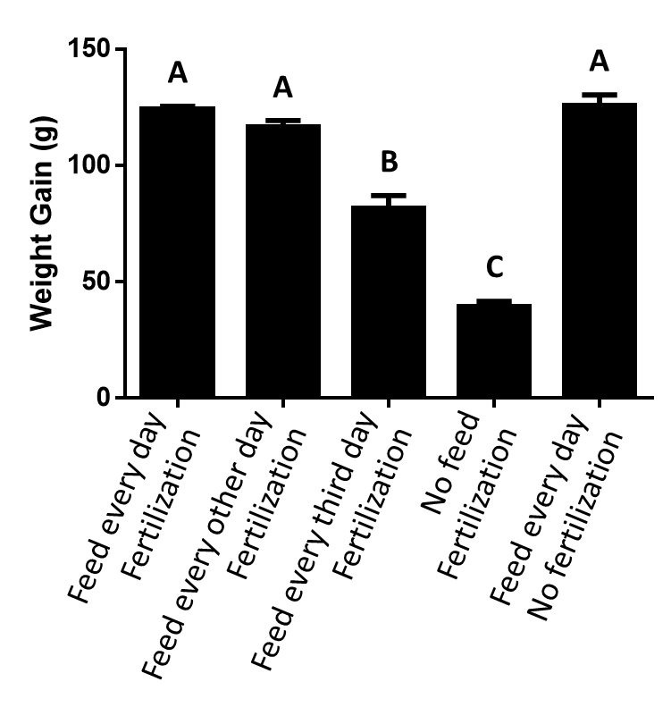
Feed every day
Fertilization
Results – Growth Metrics
Feed every other day
Fertilization
120
100
*
Feed every third day
Fertilization
80
Weight (g)
No feed
Fertilization
60
**
40
Feed every day
No fertilization
20
18
*
16
14
**
12
Length (cm)
10
8
6
4
6 Jun 14
4 Jul 14
1 Aug 14
21 May 14
20 Jun 14
18 Jul 14
16 Aug 14
30 Aug 14
15 Sep 14
Statistical significance determined by ANOVA. *p < 0.05; **p < 0.01
Notes:
Fish fed daily with or without pond fertilization and fed on alternate days with pond fertilization had no difference in weight or length gain
Ponds were not aerated. Semi-intensive culture, 5 fish/m2, high density, maximum carrying capacity of the pond without aeration O2 induction

Slide 6
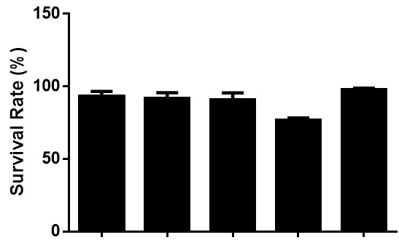
Results – Production Metrics
A
A
A
B
A
A
A
AB
C
B
Feed every day
Fertilization
No feed
Fertilization
Feed every day
Fertilization
No feed
Fertilization
Feed every day
No fertilization
Feed every day
No fertilization
Feed every third day
Fertilization
Feed every third day
Fertilization
Feed every other day
Fertilization
Feed every other day
Fertilization
Letters designate statistical differences determined by ANOVA followed by Tukey’s posthoc analysis. P = 0.05
Notes:
No observed differences in specific growth rate or survival in fish fed daily with or without pond fertilization and fed on alternate days with pond fertilization

Slide 7
Results – Economic Metrics
C
C
A
B
AB
A
BC
C
BC
A
A
A
A
A
AB
B
B
B
C
Feed every day
Fertilization
No feed
Fertilization
Feed every day
Fertilization
Feed every day
No fertilization
No feed
Fertilization
Feed every third day
Fertilization
Feed every day
No fertilization
Feed every other day
Fertilization
Feed every third day
Fertilization
Feed every other day
Fertilization
Letters designate statistical differences determined by ANOVA followed by Tukey’s posthoc analysis. P = 0.05
Notes:
Fish fed daily with or without pond fertilization and fish fed every other day along with pond fertilization had greater weight gain, higher specific growth rates and survivability, and better net production than the other two treatments. There was no difference in feed conversion ratio between ponds fed daily whether the ponds were fertilized or not. Production values taken together indicated that the benefit to cost ratio was highest for treatments fed in a pulsatile manner (i.e. fed every other day or every third day).
Based on all growth and production parameters, feeding tilapia on alternate days with pond fertilization leads to the best overall benefits in return with low FCR and high net production with no difference in growth and survival compared with fish fed daily

Slide 8
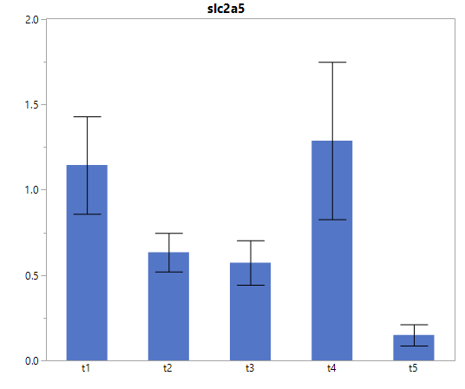
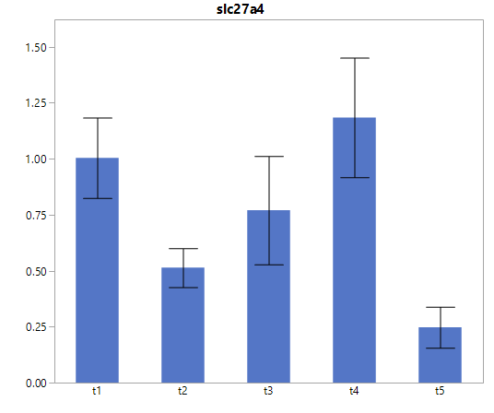
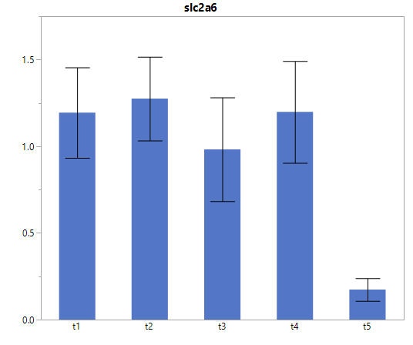
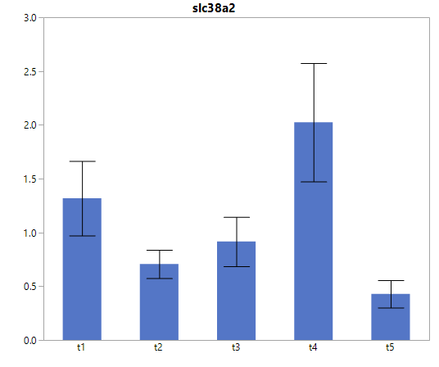
Results – Gut Nutrient Transporters
Glucose/Fructose Transporter
Fatty Acid Transporter
2
A
A
1.5
1.5
AB
A
AB
1
1
Copy No. / ng Total RNA
AB
AB
AB
0.5
0.5
B
B
0
0
Glucose Transporter
Amino Acid Transporter
A
A
3
A
1.5
A
AB
2
AB
1
Copy No. / ng Total RNA
AB
1
B
0.5
B
B
0
0
Feed every day
Fertilization
Feed every other day
Fertilization
Feed every day
Fertilization
Feed every third day
Fertilization
Feed every other day
Fertilization
Feed every third day
Fertilization
No feed
Fertilization
No feed
Fertilization
Feed every day
No fertilization
Feed every day
No fertilization
Letters designate statistical differences determined by ANOVA followed by Tukey’s posthoc analysis. P = 0.05
Notes:
Fish grown in ponds that are both fed and fertilized had an intermediate expression of certain solute transporters suggesting they may be more efficient at nutrient uptake and utilization, particularly when commercial feeds are only periodically available
This upregulation may have the effect of preparing the intestinal cells for rapid uptake of nutrients once they become present (Diamond and Karasov 1987)
Gene expression of slc38a2 (AA transporter) increases in response to an absence of amino acids. This increase leads to the translation of the gene to make the SNAT2 protein which has been shown to the recovery of cell volume following amino acid starvation or hypertonic stress (Franchi-Gazzola et al 2004; Franchi-Gazzola et al 2006; Gaccioli et al 2006; Nardi et al 2015).
In addition, amino acid transporters may serve as sensors of nutrient supplies to regulate expression of the transporters and thus nutrient uptake by the cells (Taylor 2014)
In this case again the slc38a2 would be upregulated to improve the efficiency of absorbing amino acids under limiting conditions
This may signify their intestine is conditioned for enhanced uptake in a nutrient limiting environment. By providing a diet of fish feed along with fertilization, which leads to an intermediate nutrient transporter gene expression, intestinal cells may be more efficient at nutrient uptake and utilization.
We evaluated 10 different transporters. Of those the 4 shown here were most expressed in the intestine (Anterior intestine)
NEED SOLUTE TRANSPORTER NAME
Glucose/fructose – SLC2A5
Glucose –SLC2A6
Fatty Acid –SLC27A4
Amino Acid – SLCE38A2

Slide 9
Results – Tilapia Microbiome
Feces collected (12 weeks of growth trial)
Identified microbial communities by 16S (prokaryote) and 18S rRNA (eukaryotes) sequences via QIIME using Greengenes/Silva databases
715,725 total reads after quality filtering
330,883 prokaryotic reads
384,842 eukaryotic reads
These contributed to:
20 prokaryotic phyla, 43 classes, 92 orders,145 families, and 215 species
8 major eukaryotic phyla, 132 genera, and 289 species
Notes:
QiiME (chime)
None archea, all bacteria

Slide 10
Results – Bacterial Metagenome
Phylum Level Classification and relative abundance
WS5
Verrucomicrobia
100%
Tenericutes
TM7
90%
TM6
Spirochaetes
80%
Proteobacteria
70%
Fusobacteria
Planctomycetes
OP11
60%
Nitrospirae
50%
MVP-21
Fusobacteria
40%
Firmicutes
Fibrobacteres
30%
Cyanobacteria
20%
Firmicutes
Chloroflexi
Chlamydiae
10%
Bacteroidetes
0%
Actinobacteria
Feed every day
Fertilization
Feed every other day
Fertilization
Feed every third day
Fertilization
No feed
Fertilization
Feed every day No Fertilization
Acidobacteria
Notes:
Used metagenomics package QIIME (pronounced chime) to identify OTUs (prokaryotic and eukaryotic groups) from barcoded 16S ribosomal DNA sequences
OTU = Operational Taxonomic Unit = observations of organisms identified from sequencing, and that the number of observations (reads) correlates well with the total number of individuals present in the community
Relative abundance of bacterial Phyla identified
An increase in the relative abundance of Firmicutes is indicative of obesity in mammals and positively correlated with caloric intake in bony fishes (Jumpertz et al 2011; Ley et al 2006; Turnbaugh et al 2009).
The fact that we also saw a higher proportion of Firmicutes bacteria in tilapia from treatments fed every day in fertilized ponds indicates that there may be an abundance of high-calorie food resources available to these fish.
Fusobacteria were most abundant phyla in tilapia fecal material (shown previously in cultured gut microbes)

Slide 11
Results – Bacterial Metagenome
Family/Species Level Classification
100%
Fusobacteria
Cetobacterium somerae
90%
Firmicutes
80%
Peptostreptococcaceae
70%
Clostridium perfringens
62.5%
72.5%
Other Clostridiaceae
60%
84.4%
72.0%
50%
90.8%
40%
30%
20%
10%
0%
Feed every other day
Fertilization
Feed every day
Fertilization
Feed every third day
Fertilization
No feed
Fertilization
Feed every day No Fertilization
Notes:
Relative abundance of bacteria in the fecal material of Nile tilapia subjected to varying pulsed-feeding regimes at the level of Family/Species.
Cetobacterium somerae (fusobacteria) was highest in proportion in all groups
C. somerae is an indigenous bacterium in the intestinal tract of cultured freshwater fish (Tsuchiya et al. 2008)
As this bacterium produced vitamin B12 at high efficiency, its density in the intestinal content may be involved with the requirement of freshwater fish for vitamin B12. Fish with high concentration do not have to be supplemented with B12
Vit B12 – involved in amino acid and fatty acid metabolism (how it is involved in fatty acid and amino acid metabolism?)
Peptostreptococcaceae All members of the family are anaerobes with fermentative type of metabolism. – includes some Clostridium spp. Also a common gut colonizers in fish and mammals and humans
Clostridiaceae generally monospore-forming, anaerobic Gram-positive-staining rods – includes other Clostridium spp.

Slide 12
Results – KEGG Functional Analysis - Predicted metabolic function of bacterial communities
100%
90%
Metabolism of Cofactors and Vitamins
80%
Energy Metabolism
70%
Carbohydrate Metabolism
Amino acid Metabolism
60%
Membrane Transport
50%
40%
30%
20%
10%
0%
Feed every other day
Fertilization
Feed every day
Fertilization
Feed every third day
Fertilization
No feed
Fertilization
Feed every day No Fertilization
Notes:
The metabolic functions of bacteria in the gut of tilapia was predicted using the PICRUSt package (stated as KEGG functions)
Relative abundance of the Predicted metabolic functions of the gut flora in the tilapia in this study
Predicts metabolic functions of only those identified bacteria that functions are currently known - with time, functions of other organisms may become known and these profiles may change due to that
Highest abundance of predicted functions of the gut microbes identified are involved in membrane transport and metabolism of amino acids, carbohydrates, and vitamins
The microbes could aid in the uptake and efficient utilization of nutrients for the fish

Slide 13
Results –Predicted Metabolic Function of Gut Flora that may Affect Metabolism and Nutrition in Fish
Feed every day
With fertilization
Feed every other day
With fertilization
Feed every third day
With fertilization
No feed
With fertilization
Feed every day
No fertilization
Notes:
Relative abundance of Predicted metabolic functions of the gut flora in the tilapia that may affect metabolism and nutrition of the fish

Slide 14
Results – Potential for Probiotic Development
Feed every day
Fertilization
Feed every other day
Fertilization
Potential bacteria from alternate day fish that could lead to probiotic development:
Acutodesmus obliquus – lipid production
Bacillus sp. – known probiotic
Blautia sp. – degradation of complex polysaccharide to fatty acids
Anaerovorax sp. – ferments toxic putrescine to nontoxic forms
Sphingomonas sp. – biodegrative and biosynthetic
Desulfococcus sp. – sulfate reducing, utilize acetone for growth
Notes:
Venn diagrams
45 bacterial OTUs were found in fish fed on alternate days but not is fish fed daily
Of those, 7 were identified as potential for probiotic development
Acutodesmus obliquus - lipid production
Cyanobacterium sp.
Bacillus sp. - known probiotics
Blautia sp. - degrade complex polysaccharides to short chain fatty acids including acetate, butyrate, and propionate that can be used for energy by the host
Anaerovorax sp. - ferments putrescine (breakdown of arginine; toxic) to acetate, butyrate, molecular hydrogen and ammonia
Sphingomonas sp. - biodegradative and biosynthetic capabilities (take precursors to build larger macromolecules, bioremediation/biodegradation) and oil production)
Desulfococcus sp. - sulfate-reducing is able to utilize acetone for growth

Slide 15
Results – Eukaryotic Metagenome
Phylum Level Classification
100%
Dinoflagellates, Diatoms, Oomycetes, etc.
SAR
90%
RT5iin25
80%
Opisthokonta
Incertae Sedis
70%
Excavata
60%
Cryptophyceae
Metazoans, Fungi
Archaeplastida
50%
Amoebozoa
40%
30%
20%
10%
Green Plants, Red Algae
0%
Feed every other day
Fertilization
Feed every day
Fertilization
Feed every third day
Fertilization
No feed
Fertilization
Feed every day No Fertilization
Notes:
Relative abundance of eukaryotes identified at the phylum level (8 different phyla were identified and shown here, but the majority eukaryotes belong to the opisthokonta representing meatozoans and fungi, archaeplastida,....., and the SAR supergroup)
The dominant groups identified from these samples belonged to the:
Opisthokonta (Metazoans and Fungi) (34.8%), (metazoan
Archaeplastida (green plants and red algae) (34.2%), and
SAR supergroup (Stramenopiles, Alveolates, and Rhizaria; Dinoflagellates, Diatoms, Oomycetes, etc.) (30.7%)
Oomycetes – water molds
Metazoan – multicellular eukaryotes (rotifers

Slide 16
Results – Eukaryotic Metagenome
Diatoms
Rotifers
Teleosts
Green Algae
Flowering Plants
Feed every day
Fertilization
Feed every other day
Fertilization
Feed every third day
Fertilization
No feed
Fertilization
Feed every day No Fertilization
Notes:
Total reads (~ quantified numbers) of eukaryotic groups identified with the largest groups labeled
The groups including Rotifers, green algae, diatoms, and flowering plants (i.e. corn and rice) were highest in abundance
Rotifers, green algae, and diatoms possible from natural production of pond
Flowering plant DNA potentially identified from both natural pond production and formulated diets
Teleost DNA possibly a product of the formulated diets and contamination of tilapia DNA

Slide 17
Results – Microbial Diversity
400
Prokaryotes
ND
350
300
**
250
Chao 1 Rarefaction Index
ND
Feed every day
Fertilization
200
150
100
Feed every other day
Fertilization
50
0
Feed every third day
Fertilization
10
79
148
217
286
355
424
493
562
631
700
200
*
No feed
Fertilization
Eukaryotes
ND
**
150
Feed every day
No fertilization
ND
Chao 1 Rarefaction Index
100
50
0
Statistical significance determined by ANOVA analysis. *p < 0.05; **p < 0.01
10
49
88
127
166
205
244
283
322
361
400
Number of Sequences
Notes:
Alpha diversity measures are indices of the diversity within a community. The Chao 1 index is commonly used to estimate the total number of species within a community and is based on the number of rare OTUs in that community (Chao 1984)
The bacterial diversity in the fecal material in tilapia guts decreased with increasing times between feeding when paired with pond fertilization
The highest diversity of organisms were found in fish fed on alternate days or daily along with pond fertilization
Could indicate that greatest feed conversions and other parameters could be due to increased diversity of nutrients available to the fish
Greater diversity suggests that fish in alternate day may have a more diverse food or nutrient sources and also allows for elevated diversity in bacteria that could improve nutrient utilization

Slide 18
Conclusions
No difference in growth or production parameters of Nile tilapia when employing alternate-day feeding vs. daily feeding strategies
Feed costs decreased by 50%
Nile tilapia may more efficiently utilize available nutrients when fed on alternate days
A greater diversity of organisms found in the intestines of tilapia when fed on alternate days
Potential for more diverse nutrients being available
Potential probiotic support for more efficient absorption of nutrients and general fish health

Slide 19
Funding for this research was provided by the
The AquaFish CRSP is funded in part by United States Agency for International Development (USAID) Cooperative Agreement No. EPP-A-00-06-00012-00 and by US and Host Country partners.
The contents of this presentation do not necessarily represent an official position or policy of the United States Agency for International Development (USAID). Mention of trade names or commercial products in this presentation does not constitute endorsement or recommendation for use on the part of USAID or the AquaFish Collaborative Research Support Program. The accuracy, reliability, and originality of the work presented are the responsibility of the individual authors.

Slide 20
Funding for this research was provided by the
The AquaFish CRSP is funded in part by United States Agency for International Development (USAID) Cooperative Agreement No. EPP-A-00-06-00012-00 and by US and Host Country partners.
The contents of this presentation do not necessarily represent an official position or policy of the United States Agency for International Development (USAID). Mention of trade names or commercial products in this presentation does not constitute endorsement or recommendation for use on the part of USAID or the AquaFish Collaborative Research Support Program. The accuracy, reliability, and originality of the work presented are the responsibility of the individual authors.

Slide 21
Acknowledgements

Slide 22
Results – Functional Analysis Predicted from Metagenome
Feed every other day
With fertilization
Feed every day
No fertilization
* = p < 0.05
** = p < 0.01
Notes:
Relative abundance of the Predicted metabolic functions of the gut flora in the tilapia fed on alternate days with fertilization vs those fed daily without fertilization
Top functions for classification into these two treatments – performed with Weka (support vector machine)
Higher proportions of metabolism functions of bacteria in tilapia fed daily without pond fertilization vs those fed on alternate days with pond fertilization may indicate that there are more of these components in the guts of the tilapia fed daily than alternate days, thus increasing the necessary need for higher metabolic rates
Cell motility: cytoskeleton proteins
Signaling molecules and interaction: ion channels, bacterial toxins, cellular antigens
Xenobiotics biodegradation and metabolism: drug and chemical degradation

Slide 23
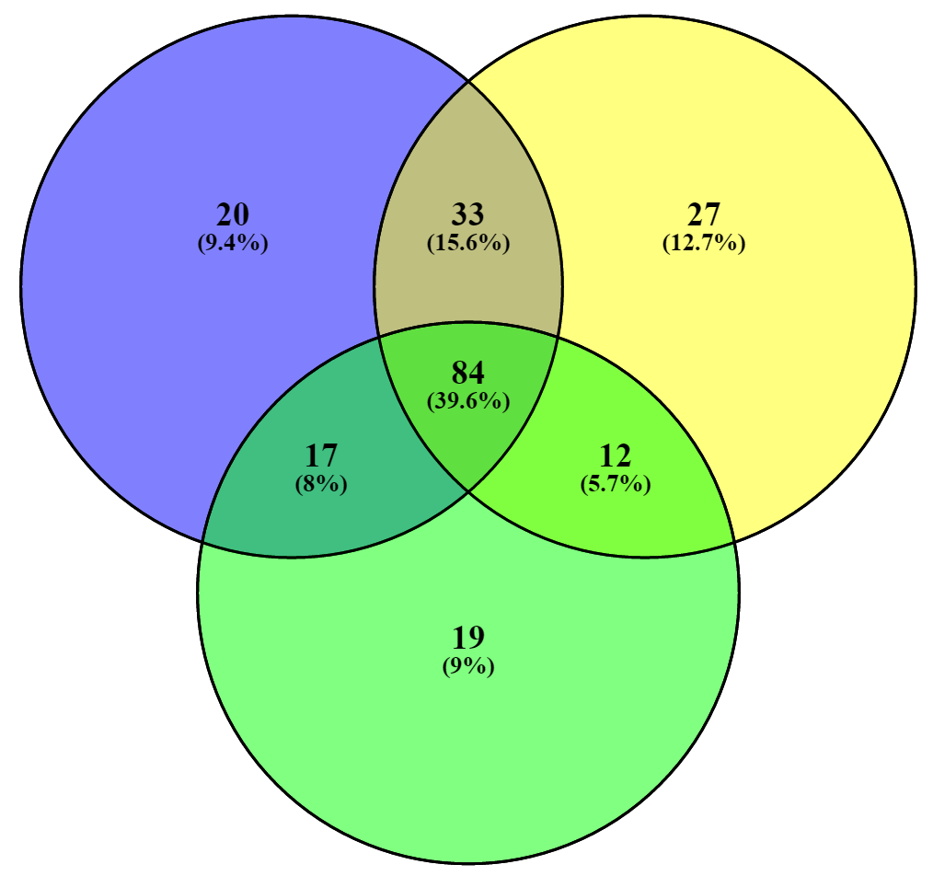
Results –
Feed every other day
Fertilization
No feed
Fertilization
Feed every day
No fertilization
Notes:
Think about this.

Slide 24
Results – Eukaryotic Metagenome
100%
4.7%
3.9%
0.4%
8.1%
Diatoms
90%
20.5%
Rotifers
80%
Teleosts
Green Algae
70%
Flowering Plants
60%
8.5%
9.3%
35.3%
30.5%
35.0%
23.9%
18.9%
34.1%
24.2%
50%
35.5%
40%
14.8%
30%
14.8%
6.8%
6.8%
23.7%
27.1%
23.7%
20%
27.1%
19.1%
20.1%
12.5%
10%
12.5%
3.4%
5.7%
2.4%
0%
Feed every other day
Fertilization
Feed every day
Fertilization
Feed every third day
Fertilization
No feed
Fertilization
Feed every day No Fertilization
Notes:
Relative abundance of eukaryotic groups identified (no one has utilized metagenomics to our knowledge to characterize the eurkaryotes in gut of tilapia)
The groups including Rotifers, green algae, diatoms, and flowering plants (i.e. corn and rice) were highest in abundance
Rotifers, green algae, and diatoms possible from natural production of pond
Flowering plant DNA potentially identified from both natural pond production and formulated diets
Teleost DNA possibly a product of the formulated diets and contamination of tilapia DNA

Slide 25
Background
Small-scale tilapia farmers in underdeveloped countries (e.g. Bangladesh) often use extensive culture practices, where fertilizer is added to stimulate pond primary production but no feeds are used (Belton et al 2011)
Even modest amounts of feed (semi-intensive) can effectively quadruple production, promoting increases in personal household income and fish consumption, and greater food security for impoverished farmers (Belton et al 2011; Dey et al 2008)
Reducing costs of feed, which comprises 50-70% of total production costs, is critical for enhancing incomes and sustainability

