Slide 1
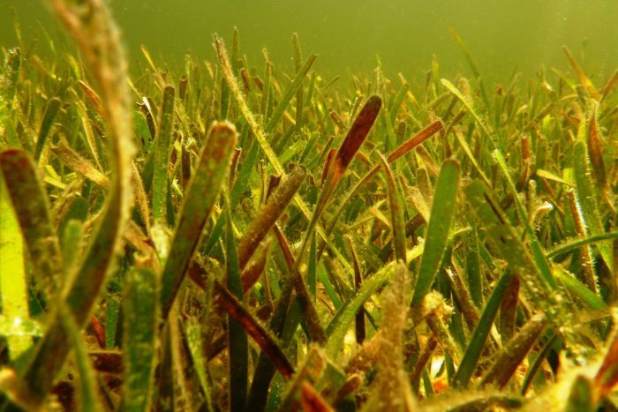
Thalassia – turtlegrass tropical/semi-tropical

Slide 2
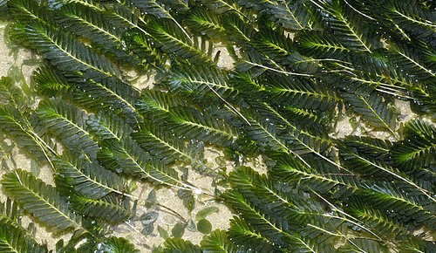
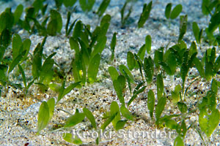
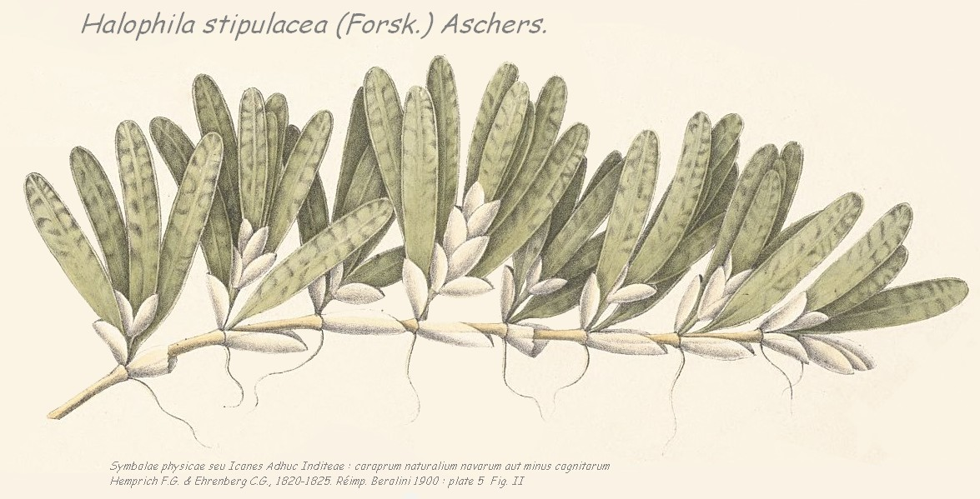
Halophila – seagrass up to 85 m deep tropical semi-tropical

Slide 3
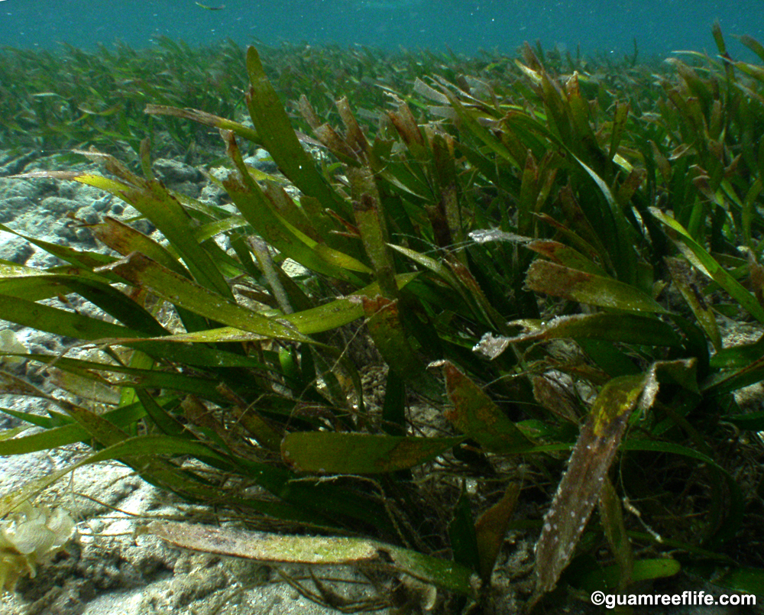
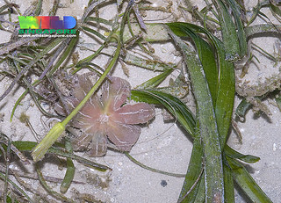
Enhalus – Lamon – tape seagrass
tropical

Slide 4
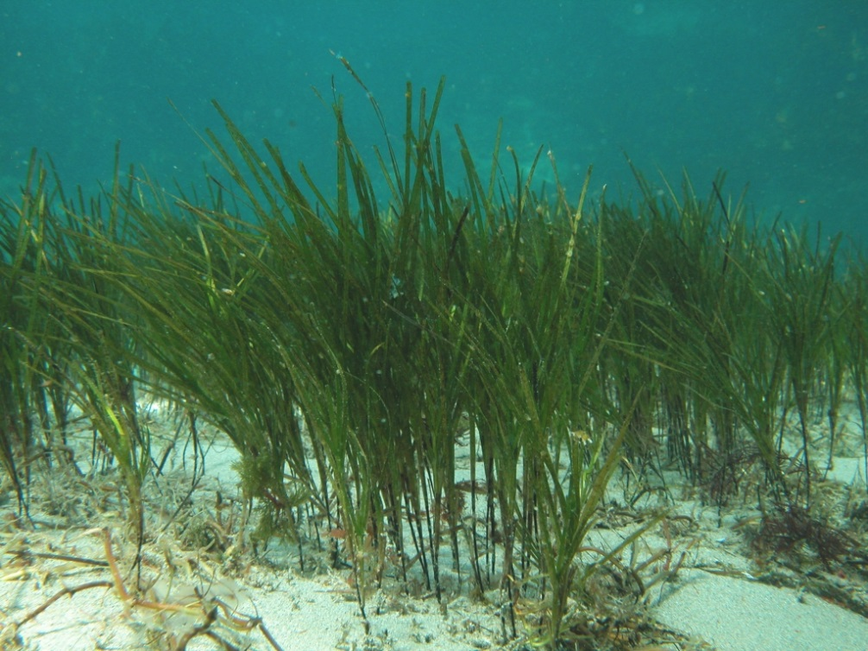
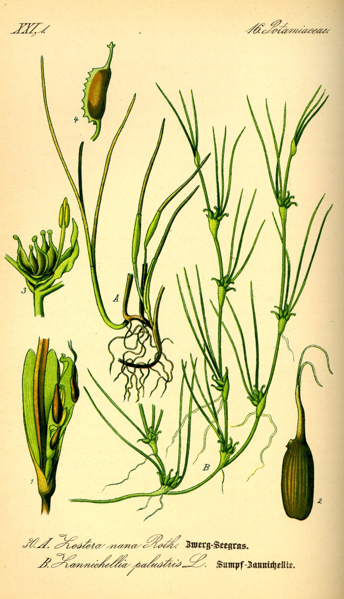
Zostera – eelgrass tropical, temperate

Slide 5
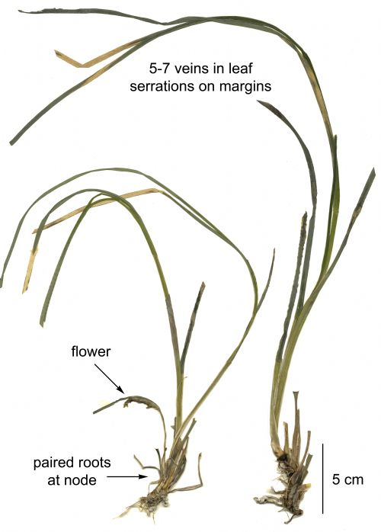
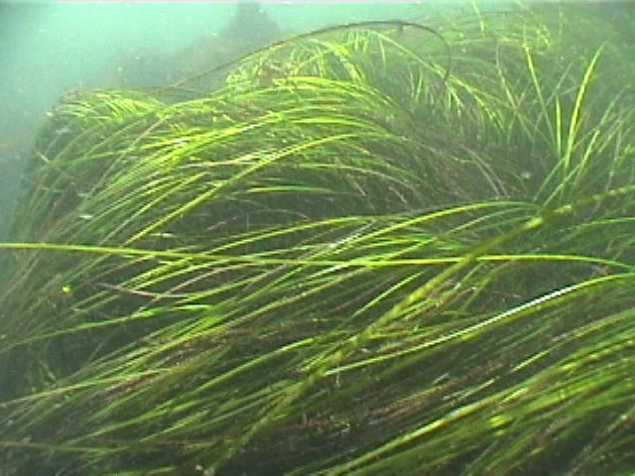
Phyllospadix – surfgrass – temperate zone
(Alaska)

Slide 6
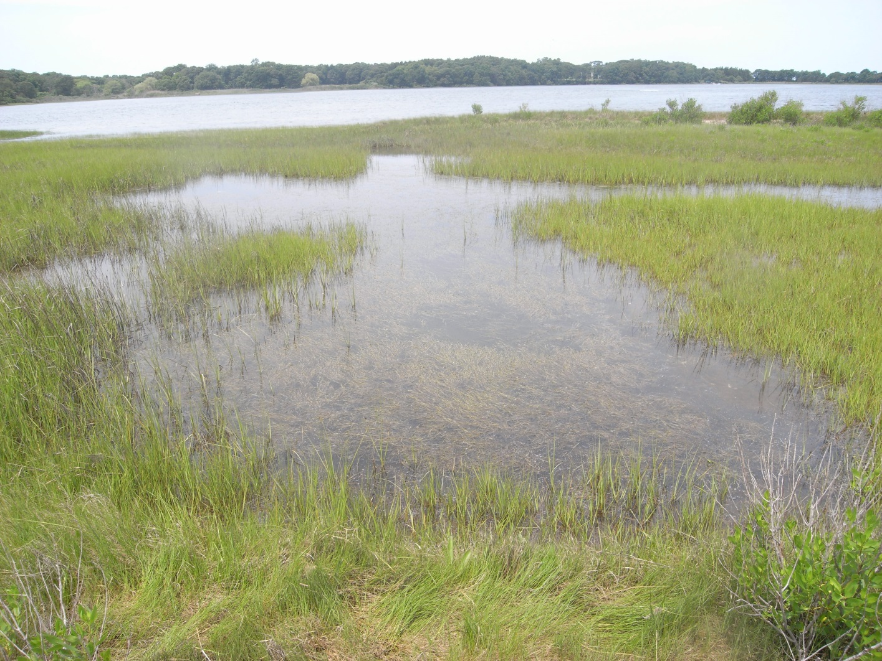
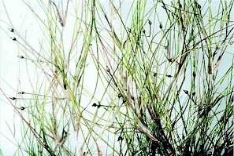
Ruppia – widgeon grass – brackish tropical, temperate

Slide 7
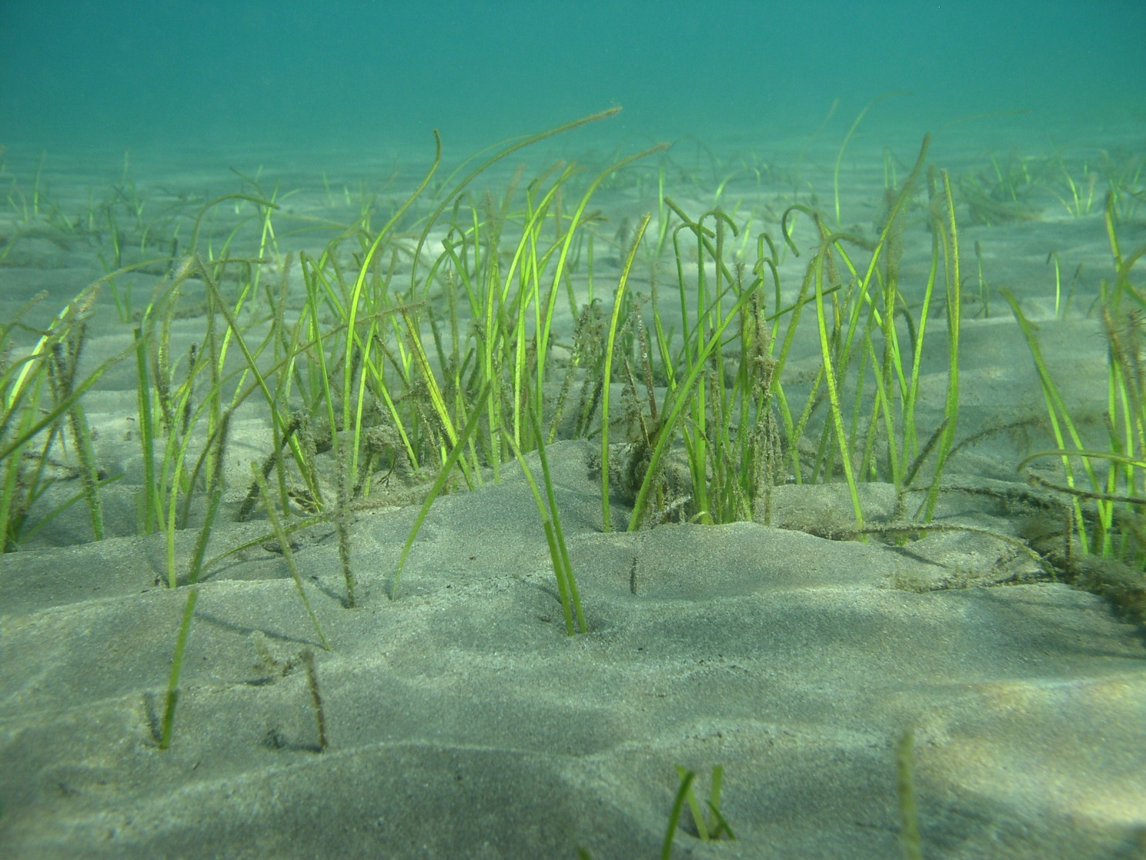
Cymodacea – slender seagrass - tropical

Slide 8
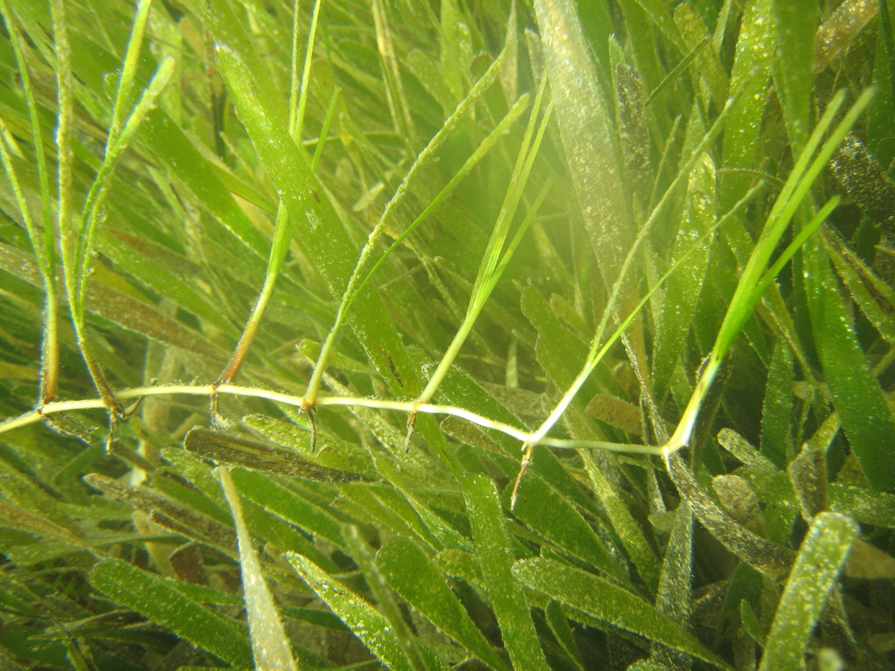
Halodule – shoal grass semi-tropical, tropical

Slide 9
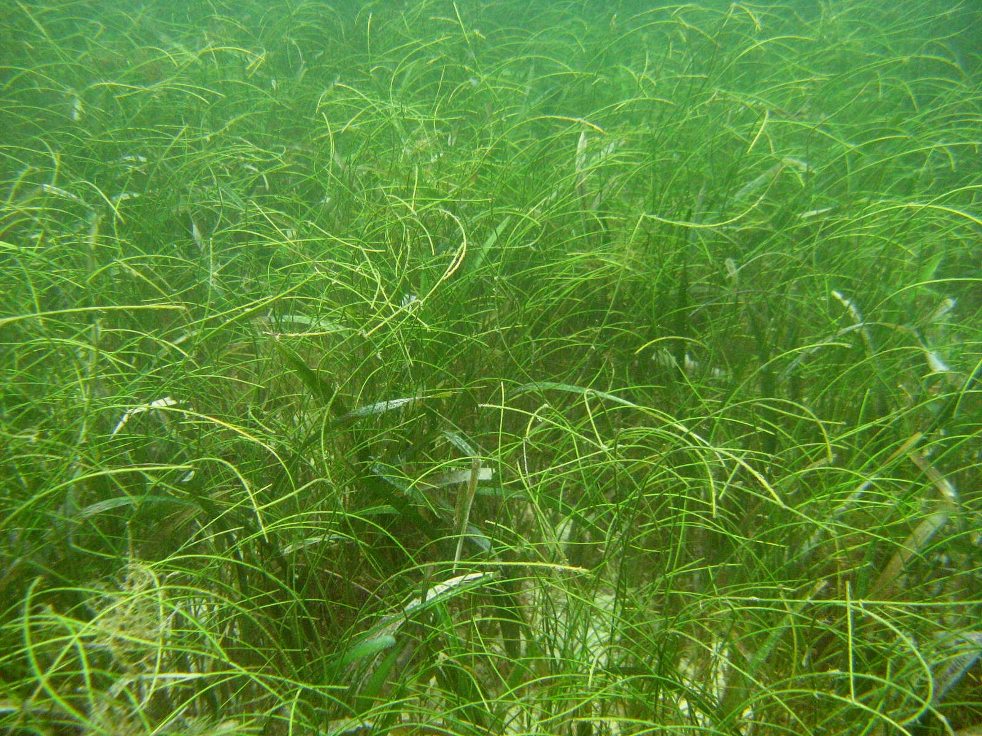
Syringodium – manatee grass – tropical, semi-tropical

Slide 10
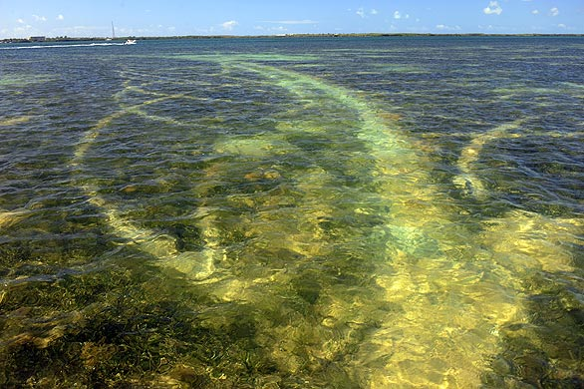
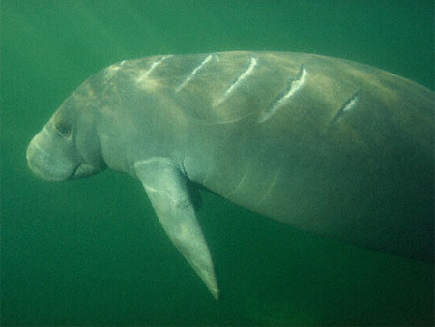
Boat damage to seagrass beds,
manatees

