Slide 1
Tilapia Global Supply and Demand in 2013.
Kevin Fitzsimmons, Ph.D.
University of Arizona, Professor of Environmental Science
World Aquaculture Society, Past-President
Aquaculture without Frontiers, Past-Chairman
American Tilapia Alliance, Sec. Tres.
Adelaide, Australia .
June 2014

Slide 2
Tilapia: continuing to increase in popularity globally
Tilapias are second only to the carps as a farmed food fish.
In 2012 the global volume of farmed fish exceeded global volume of beef for the first time (FAO)
Tilapia have unique characteristics that will facilitate its continued growth to someday surpass carp production.

Slide 3
Global production of some major farmed fishes
Metric tons per year

Slide 5
2008 Tilapia exports from China

Slide 6
2012 Tilapia exports from China

Slide 7
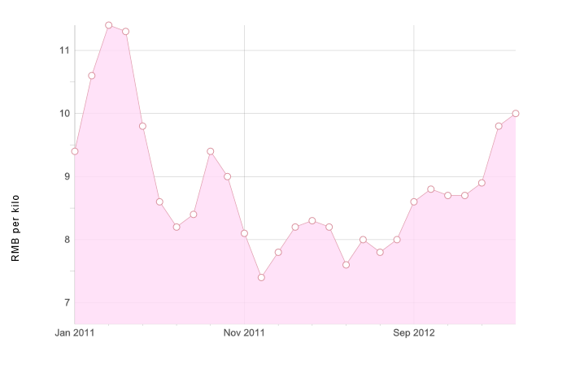
Farm gate prices for tilapia to Chinese farmers
Ex-farm prices for whole, live tilapia, China, 500-800 grams
Nov. 2013: RMB 10.0 ($1.60/kg)

Slide 8
Global production of tilapia

Slide 9
Top Ten Seafoods (U.S.) per capita (lbs)

Slide 10
US Consumption of tilapia from domestic and imported sources

Slide 11
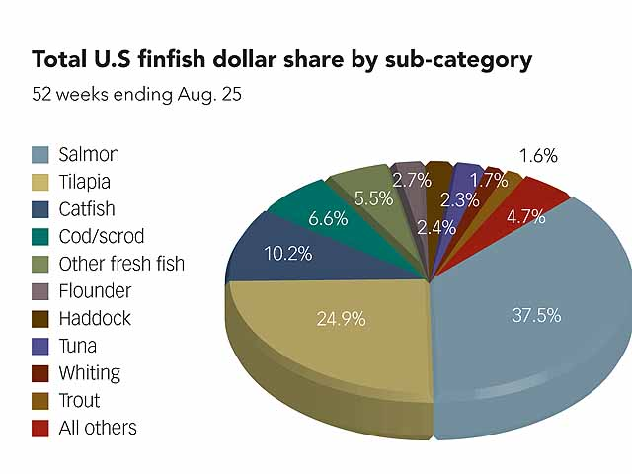
Percentage of US finfish grocery sales: weekly sales averaged $608 per store

Slide 12
US Tilapia consumption (imports and domestic) 437,000 mt of live weight (equivalent) - 2007 453,264 mt of live weight (equivalent) – 2008 465,953 mt of live weight (equivalent – 2009) 579,443 mt of live weight (equivalent – 2010) 513,361 mt of live weight (equivalent – 2011) 613,406 mt of live weight (equivalent – 2012)

Slide 13
$696,085,981(2009) $842,866,006(2010), $838,349,634 (2011) $986,127,852 (2012)

Slide 14
US Sales of tilapia
Imports to US in 2012 were $986,127,852
US production of 28,000,000 lbs at farm
2012 US tilapia farm-gate sales were $84,000,000
2012 US Tilapia Sales estimate –
$986,127,852 + $84,000,000 = $ 1,070,127,852

Slide 15
Selective breeding and genetic improvements
Excellent breeding programs - G.I.F.T. - Malaysia - Acuaplan - Mexico - Genomar - Brasil and Norway - Chitralada – Thailand - TabTim – Thailand (CP Group) - GIFT Excell – Philippines - Molobicus - Philippines - GIFT Bangladesh
Several in Israel
YY Supermale - Philippines and Swansea, Egypt and Indonesia

Slide 16
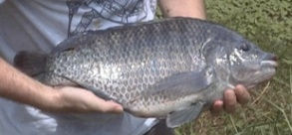
Genetic improvements in tilapia
(From: Mair, G., 2002)

Slide 17
Tilapia Genome Project
March 2011 - First assembly of the tilapia genome
Oreochromis niloticus – Nile Tilapia
http://www.broadinstitute.org/ftp/pub/assemblies/fish/tilapia/Orenil1/
Matching many segments to those known from other fish
Publically available and freely accessible
Next frontier of genetic program for tilapia

Slide 18
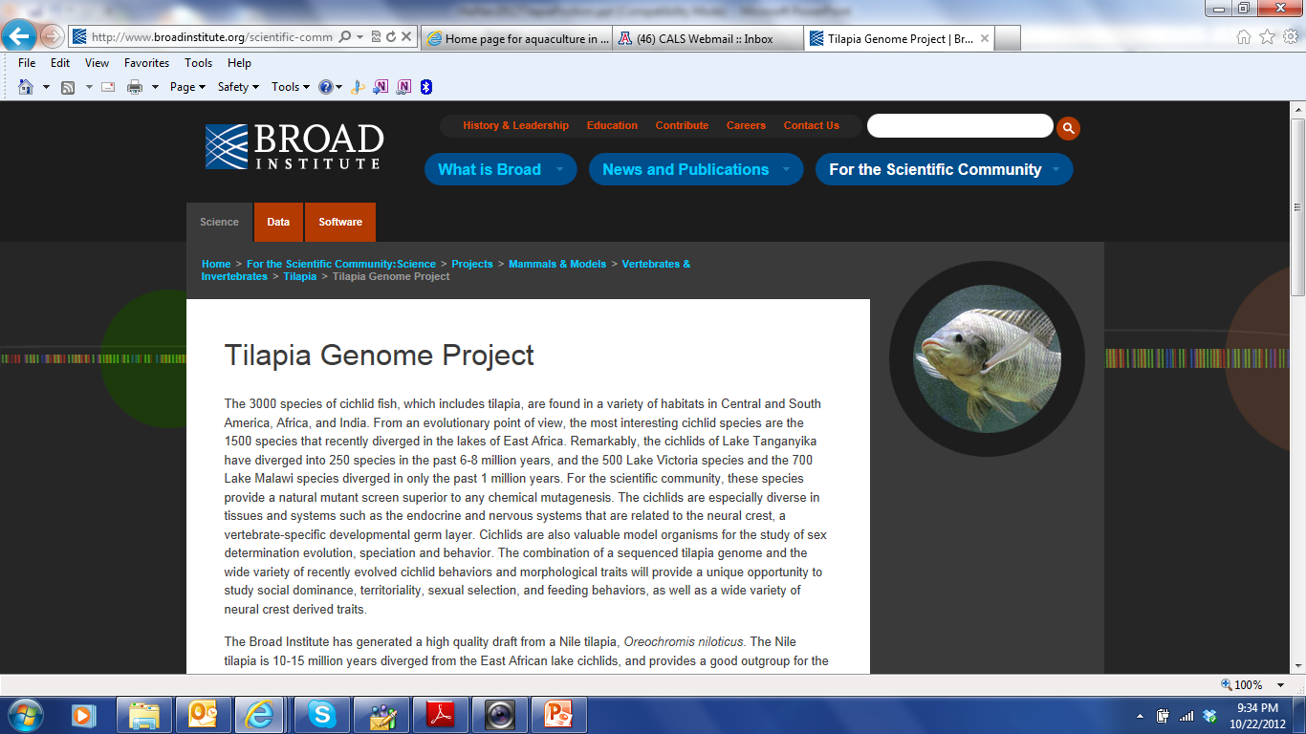

Slide 19
The YY male technology
(GMT®)

Slide 20
Regions of rapid production growth
Vietnam – conversion of catfish cages to tilapia in Mekong, and culture in all regions
Indonesia – cage culture, polycultures, rice culture
Malaysia – government support and private sector investment
Bangladesh – government support and private sector investment
Brasil – lots of available water, labor, land, feed
Thailand – better reporting, shrimp polyculture
Mexico – continued intensification, some govt support, large and small private investments
Sub-Saharan Africa - commercialization

Slide 21
Mexico
4623 licensed farms
20,000 ton Dos Lagos farm in Chiapas
Second farm now started, also by Regal Springs

Slide 22
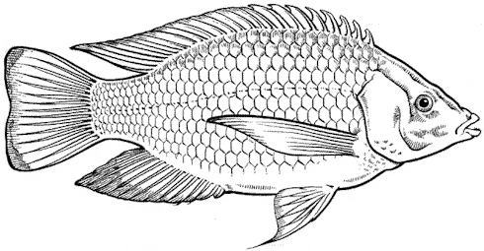
Pathways in the use of tilapia as biomanipulator (and disease control?) in shrimp farms for Vibrios and EMS
Promotion of Chlorella dominance
Feeding on organic waste
Bioturbation of sediment
Production of natural antimicrobials
IMPROVED SEDIMENT QUALITY
IMPROVED WATER QUALITY
SUPRESSION OF GROWTH OF V. harveyi and V. parahaemolyticus ?

Slide 23
Stocking and harvest schedule

Slide 24
Improvements in packaging

Slide 27
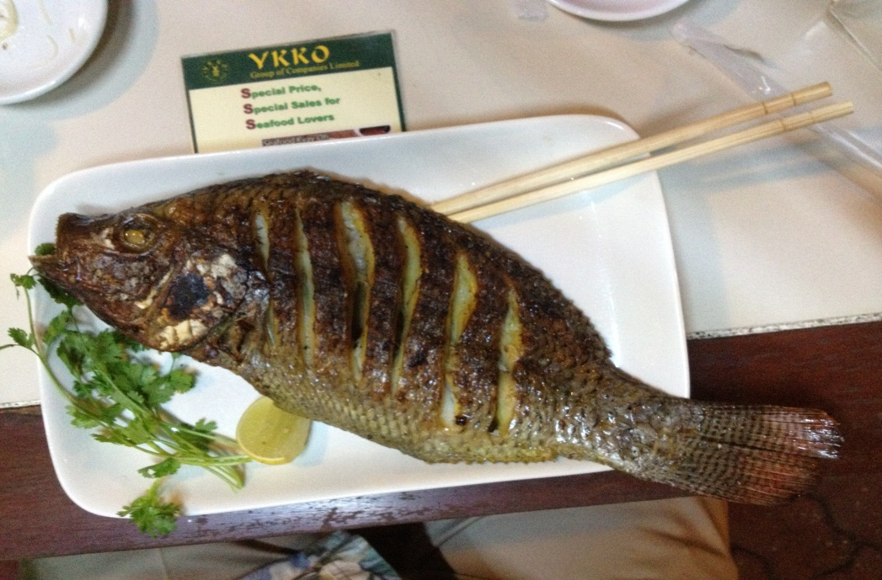
Traditional product forms
Yangon BBQ tilapia

Slide 28
Mexican-American street foods
Courtesy: Randall Brummett

Slide 29
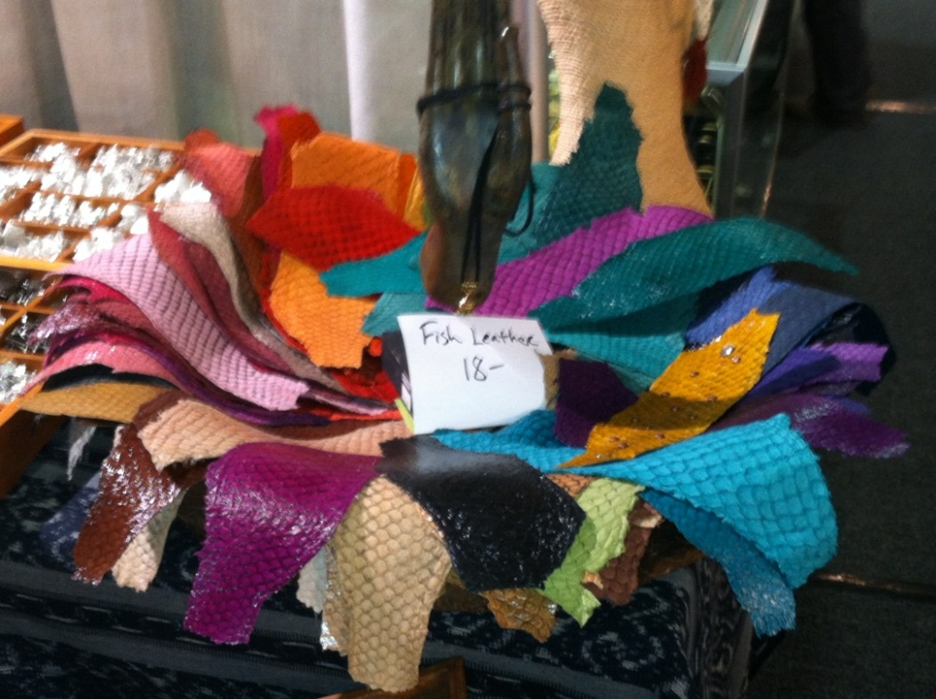
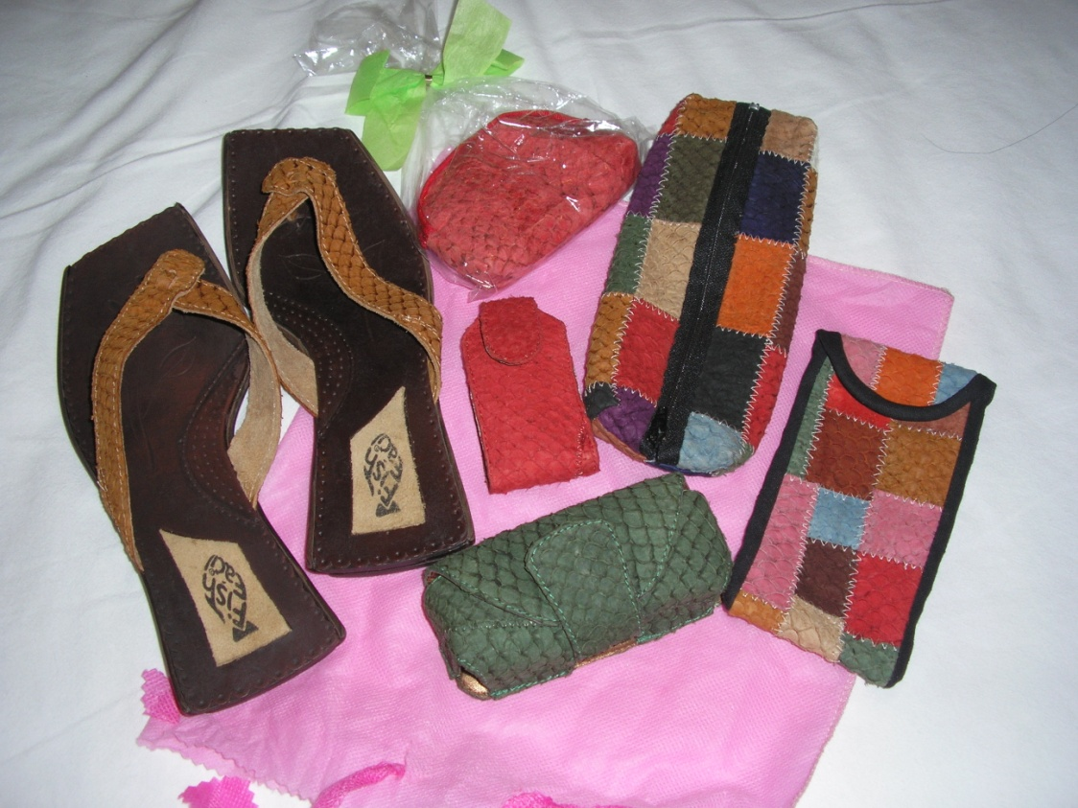
Byproducts - Tilapia Leather

Slide 30
Pet treats

Slide 31
Tilapia Orange Juice

Slide 33
Tilapia pedicures and manicures

Slide 34
Global Tilapia Market Trends
Prices have been constant, only fresh fillets have increased significantly, will not see increases beyond inflation
$/kg

Slide 35
Tilapia Global Aquaculture Production
Sources: 1990-2009: FAO and Kevin Fitzsimmons; 2010-2012: Average of Helga Josupeit and Kevin Fitzsimmons estimates; 2013: Kevin Fitzsimmons; Prices US import frozen tilapia Jan- Jun: NMFS
Notes:
35

Slide 36
Farmed Mexican tilapia fillets in Tucson, Arizona Safeway $15/kg

Slide 37
Global Aquaculture Tilapia Sales
For year 2000 =US $ 1,615,321,000 (FAO FishStat 2007)
2005 sales = $ 2,457,312,000 (FAO FishStat 2007)
2010 sales = $ 5,680,410,000 (FAO FishStat 2012)
2012 sales = $ 7,656,257,000 (FAO FishStat 2014)
2013 sales > $ 9,000,000,000

Slide 38
Bangladesh tilapia aquaculture

Slide 39
Future global tilapia aquaculture

Slide 40
ISTA 11
Surabaya, Indonesia
In conjunction with WAS Asia-Pacific Chapter
Regal Springs, Surya University, Matahari Sakti Feeds, AquaFish Innovation Lab, WorldFish, and Aquaculture without Frontiers
May 2016

Slide 41
Conclusions
Tilapia has long been called the aquatic chicken.
Instead…...
The “terrestrial tilapia”

Slide 42
Conclusions
Global tilapia production was 4,507,002 metric tons in 2012 (FAO, 2014), should exceed 4,800,000 MT in 2014. (6% growth)
Constantly improving farming, processing and packaging for food safety, quality assurance, traceability, and environmental safeguards (with little, if any, increase in price).
Other aquaculture species will follow the tilapia model.

Slide 43
Buy TILAPIA
Thank you
Questions?

Slide 44
Tilapia: the most fun aquaculture species of the 21st century
http://www.youtube.com/watch?v=Bh2673ncWJg

